Slide 1
Year 11 French speaking trial exam revision lessons
Higher
Independent revision outside of lessons:
Memorise the speaking questions for your chosen topic (Module 1, 2, 3, 4, 5 or 6)
Practise read aloud cards from this booklet
Practice role plays cards from this booklet
Practise photo cards available from this booklet
Record yourself saying your speaking question answers from memory
Listen to French Radio
Watch French programmes on Netflix, Amazon Prime or Channel 4
Little and Often is the key!
All this is on Google Classroom!
When?
w/c 8th Dec (band 1)
w/c 15th Dec (band 2)
Where?
Meeting Room 1 (above Chine)

Slide 2
Choose your conversation topics (16 out of 50 marks)
A) Module 1 Family & friends + Module 2 Free time
B) Module 3 School + Module 8 studying and my future
C) Module 4 Healthy lifestyle + Module 2 Free time
D) Module 5 Holidays + Module 2 Free time (or Module 4 healthy lifestyle)
E) Module 6 Environment + Module 7 my neighbourhood

Slide 3
Choose your conversation theme (16 out of 50 marks)
Theme 1: My personal world (module 1, 2 and 7)
Theme 2: Media and technology (module 2)
Theme 3: Studying and my future (module 3 and 8)
Theme 4: Lifestyle and wellbeing (module 4)
Theme 5: Travel and tourism (module 5)
Theme 6: My neighbourhood (module 6 and module 7)

Slide 4
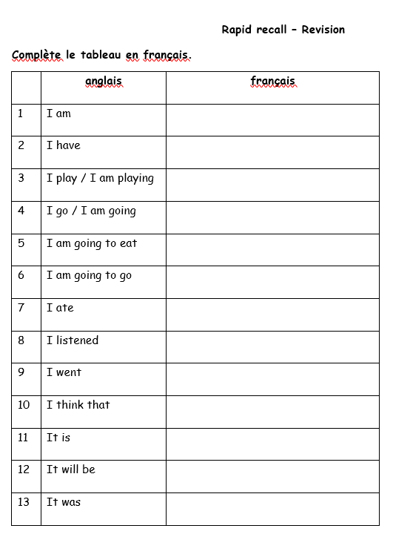
Gold challenge: Write your top 5 higher structures in French
1- ____________________________
2- ____________________________
3- ____________________________
4- ____________________________
5- ____________________________

Slide 5
Speaking Higher (15 mins preparation + 10-12 mins speaking exam)
Arrive on time in Meeting Room 1
Wait for the invigilator to greet you
No phones or any other electronic equipment allowed
Bring a pen
Your teacher will give you the read aloud card, the role play card and the photo card
Prepare notes for the role play card and the photo card (14 mins)
Write notes on the lined paper provided, NOT on the cards.
Enter the exam room with the cards and your notes when told by your teacher
Practice the read aloud task for 1 minute in the exam room.
Start the speaking trial exam

Slide 6
Speaking trial exams (higher tier)
14-minute preparation in MR1 + 1-minute preparation in exam room
Task 1: read aloud task (approx. 2 - 2.5 minutes)
Task 2: role play task (approx. 1 - 1.5 minutes)
Task 3 (based on your chosen topic): - photo task description
- follow on questions (2 – 2.5 mins)
- conversation (5 – 5.5 mins)

Slide 7
Task 1: read aloud task
Two marks per answer (12 marks out of 50)
Read aloud a short passage in French (50-55 words / 4 sentences)
8 marks
Answer 2 follow-on questions (one like and one opinion)
Answers must short and concise
4 marks

Slide 8
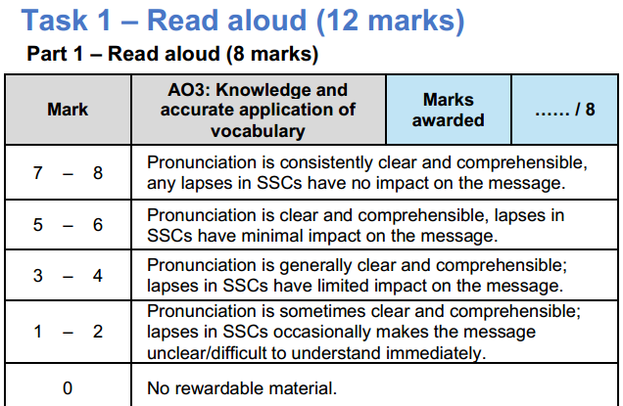
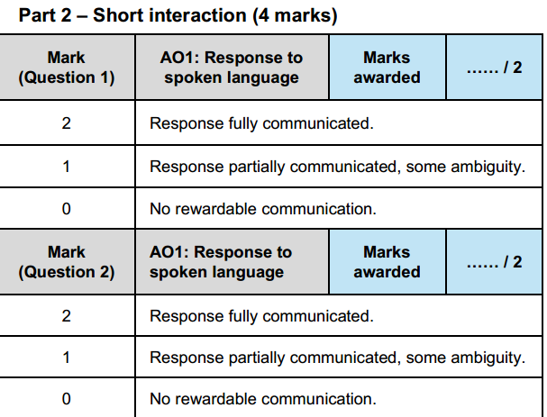

Slide 9
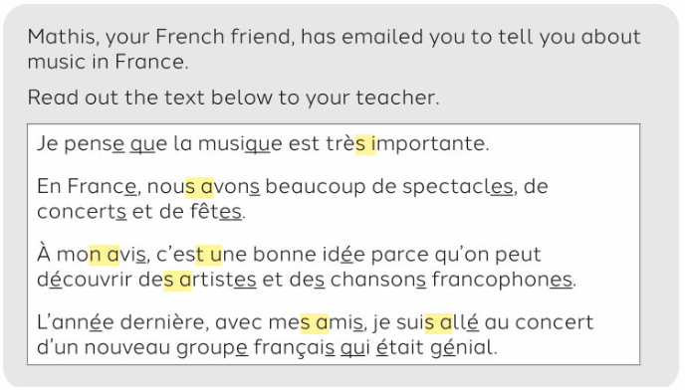
Higher textbook page 26
Follow-on questions
Q1: ____________________________________________________________________
A1: ____________________________________________________________________
Q2: ____________________________________________________________________
A2: ____________________________________________________________________

Slide 10
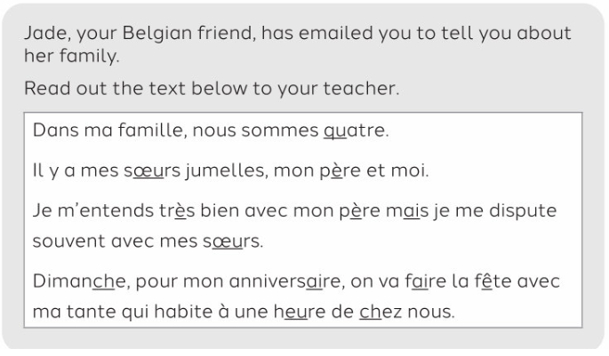
Higher textbook page 50
Follow-on questions
Q1: ____________________________________________________________________
A1: ____________________________________________________________________
Q2: ____________________________________________________________________
A2: ____________________________________________________________________

Slide 11
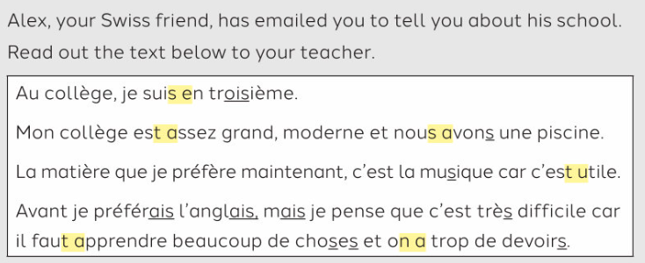
Higher textbook page 76
Follow-on questions
Q1: ____________________________________________________________________
A1: ____________________________________________________________________
Q2: ____________________________________________________________________
A2: ____________________________________________________________________

Slide 12
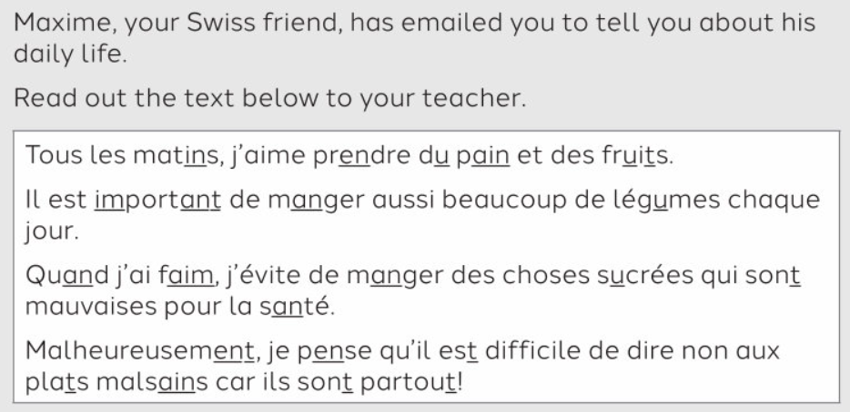
Higher textbook page 100
Follow-on questions
Q1: ____________________________________________________________________
A1: ____________________________________________________________________
Q2: ____________________________________________________________________
A2: ____________________________________________________________________

Slide 13
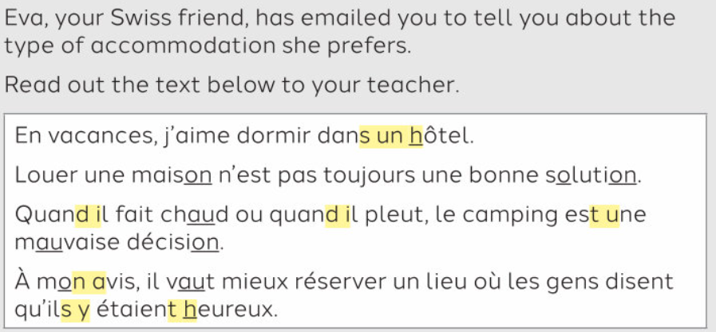
Higher textbook page 124
Follow-on questions
Q1: ____________________________________________________________________
A1: ____________________________________________________________________
Q2: ____________________________________________________________________
A2: ____________________________________________________________________

Slide 14
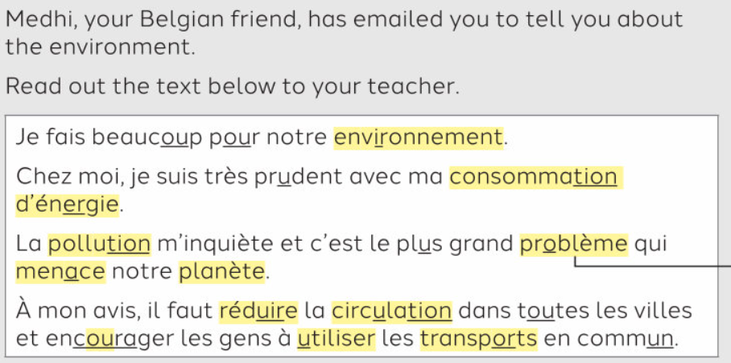
Higher textbook page 152
Follow-on questions
Q1: ____________________________________________________________________
A1: ____________________________________________________________________
Q2: ____________________________________________________________________
A2: ____________________________________________________________________

Slide 15
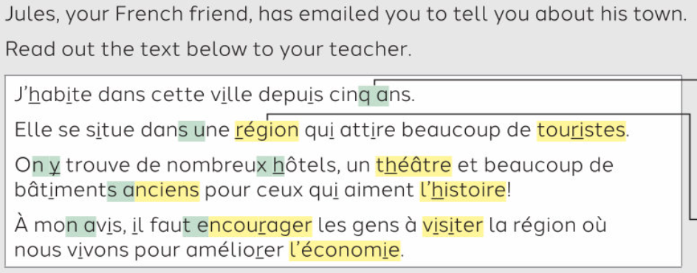
Higher textbook page 176
Follow-on questions
Q1: ____________________________________________________________________
A1: ____________________________________________________________________
Q2: ____________________________________________________________________
A2: ____________________________________________________________________

Slide 16
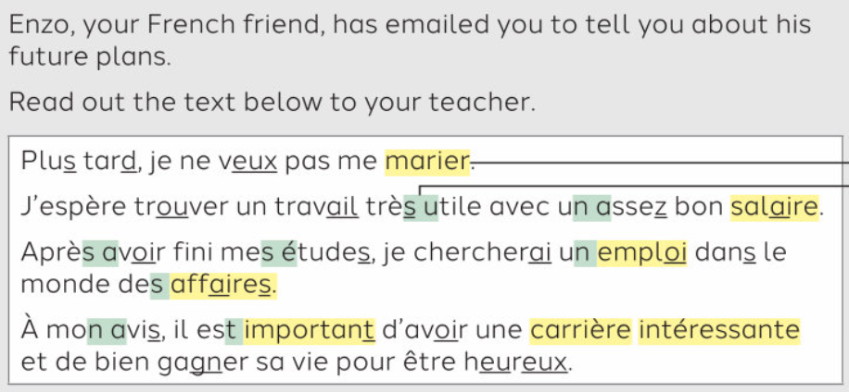
Higher textbook page 198
Follow-on questions
Q1: ____________________________________________________________________
A1: ____________________________________________________________________
Q2: ____________________________________________________________________
A2: ____________________________________________________________________

Slide 17
Task 2: Role play card
Two marks per answer (10 marks out of 50)
Short answers
Students answer 3 questions.
Answers must short and concise
Students ask 2 questions to the examiner
Students can ask the teacher to repeat the question (“Répétez s’il vous plait?”)
Teachers can not change the wording of the questions

Slide 18
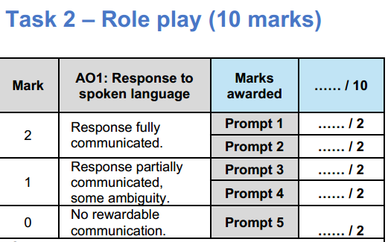

Slide 19
Role play key phrases
1 | I would like | Je voudrais
2 | I like | J’aime
3 | Because | Parce que
4 | I went | Je suis allé
5 | I did | J’ai fait
6 | I ate | J’ai mangé
7 | Is there? | Il y a ?
8 | Can I? | Je peux?
9 | Where is? | Où est?
10 | Where are? | Où sont?
11 | What do you think of? | Qu’est-ce que tu penses?
12 | Do you like? | Tu aimes?

Slide 20
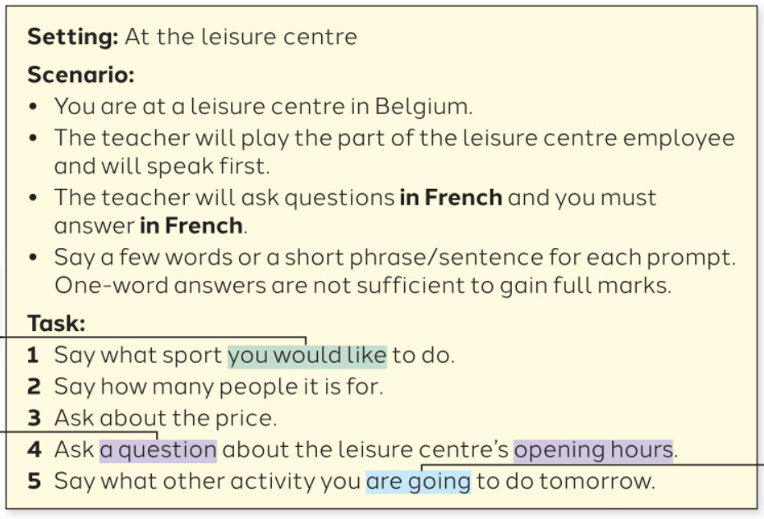
Higher textbook page 26
Instructions: Fill in the table with your own answer in French for prompt 1 to 5
1
2
3
4
5

Slide 21
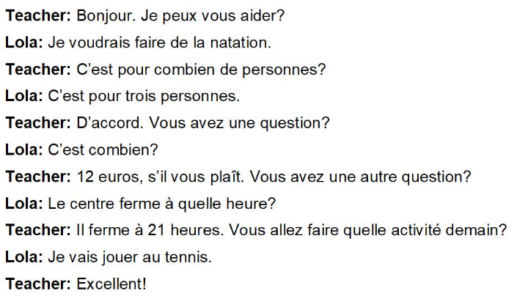

Slide 22
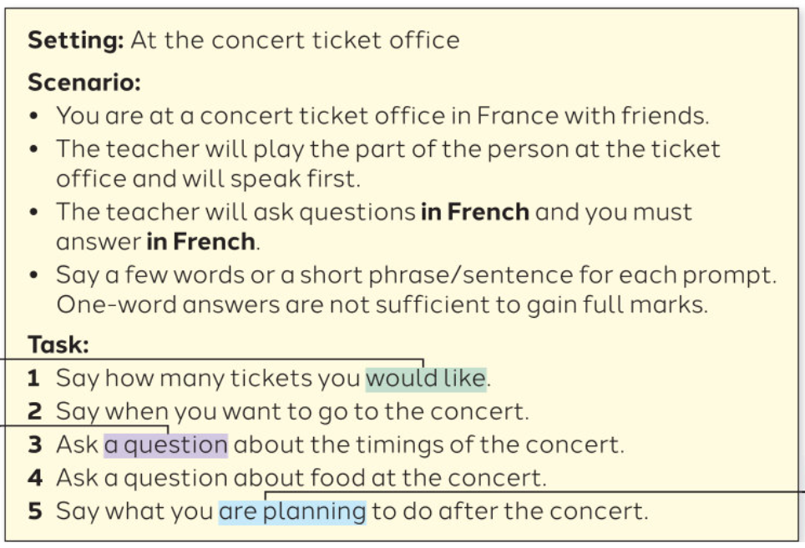
Higher textbook page 50
Instructions: Fill in the table with your own answer in French for prompt 1 to 5
1
2
3
4
5

Slide 23
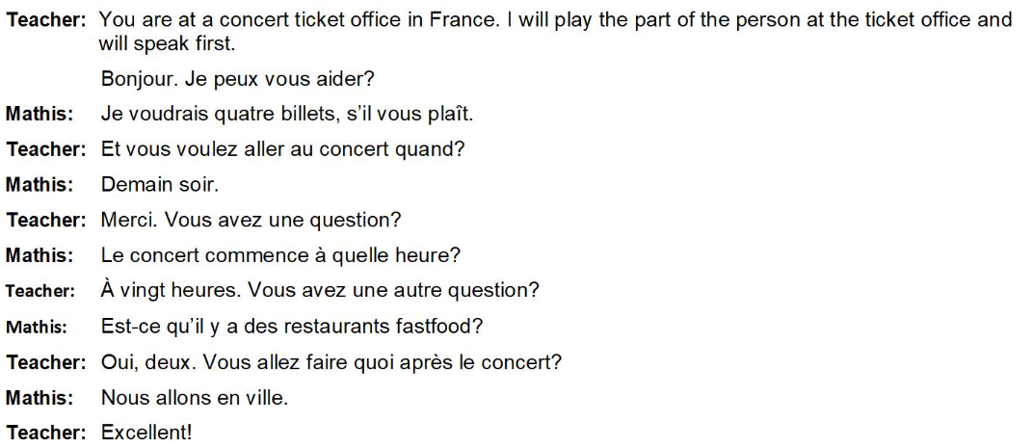

Slide 24
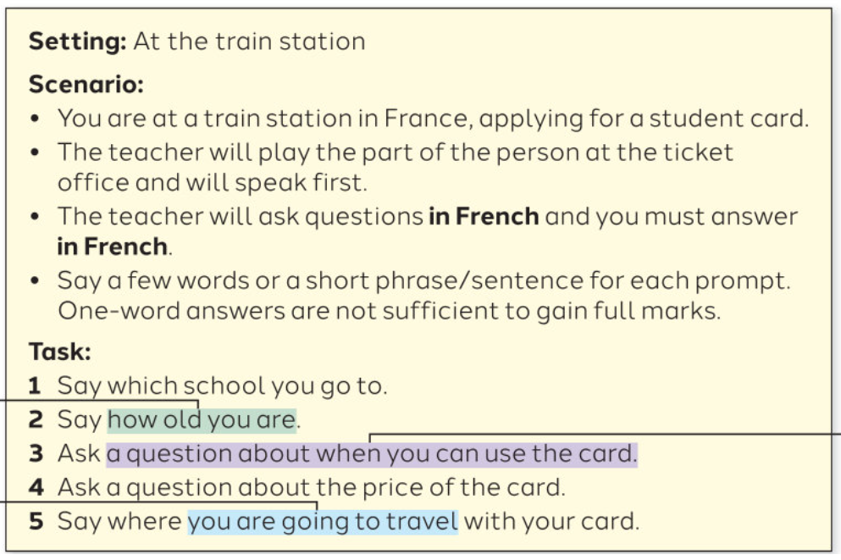
Higher textbook page 76
Instructions: Fill in the table with your own answer in French for prompt 1 to 5
1
2
3
4
5

Slide 25
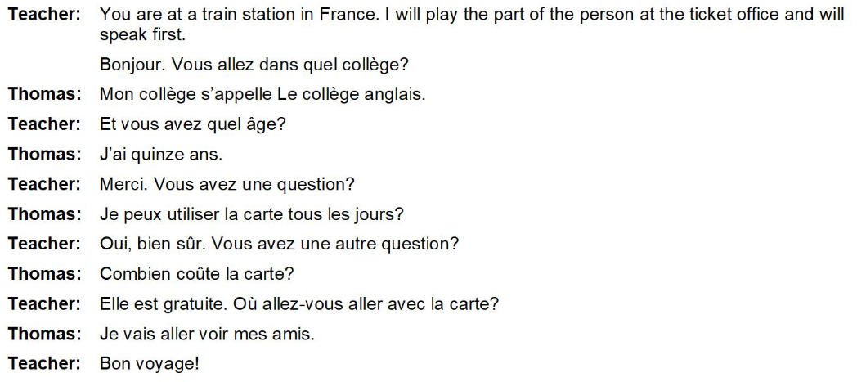

Slide 26
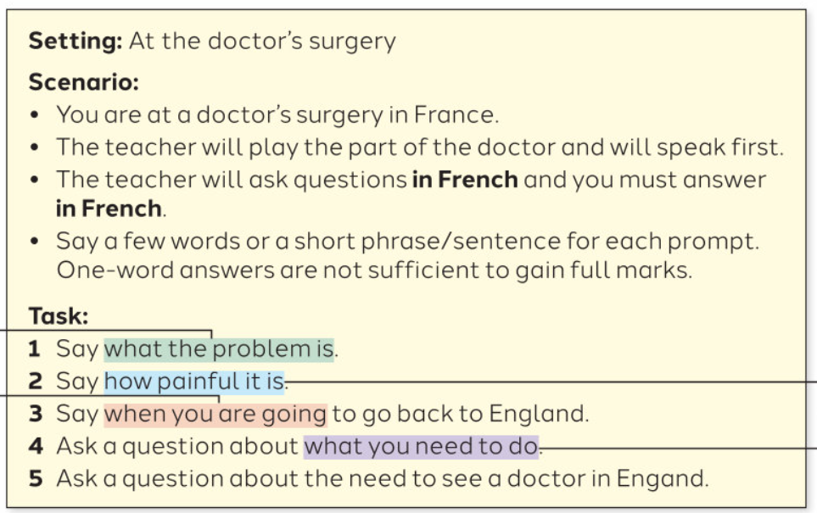
Higher textbook page 100
Instructions: Fill in the table with your own answer in French for prompt 1 to 5
1
2
3
4
5

Slide 27
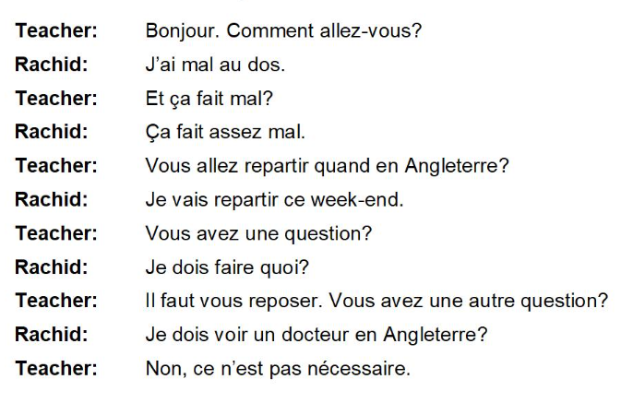

Slide 28
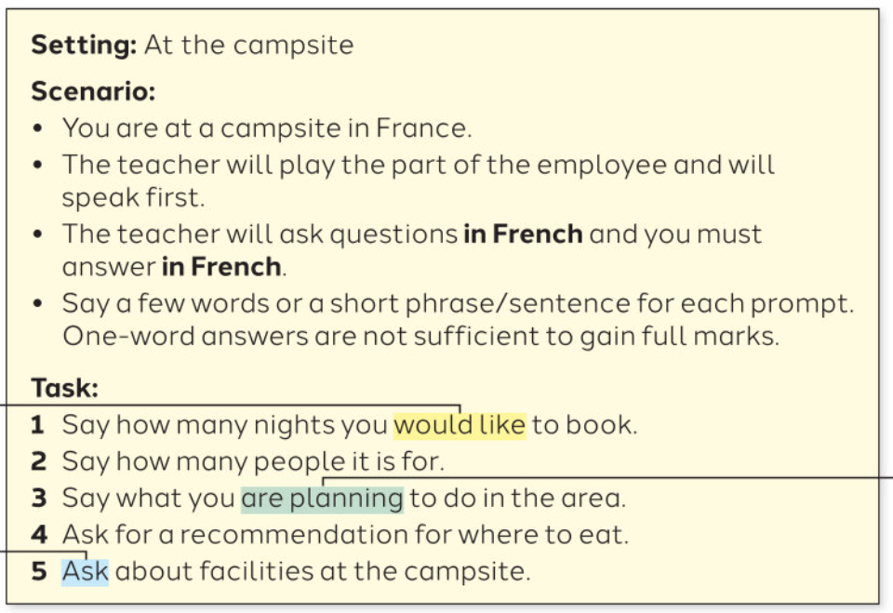
Higher textbook page 124
Instructions: Fill in the table with your own answer in French for prompt 1 to 5
1
2
3
4
5

Slide 29
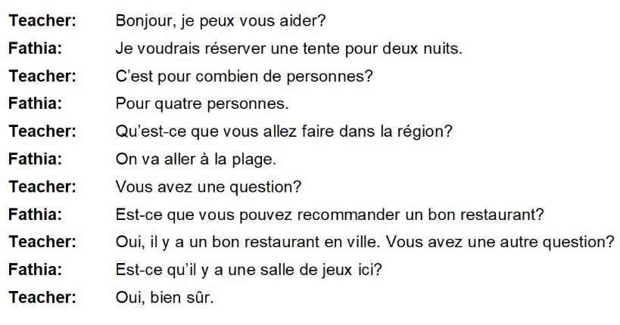

Slide 30
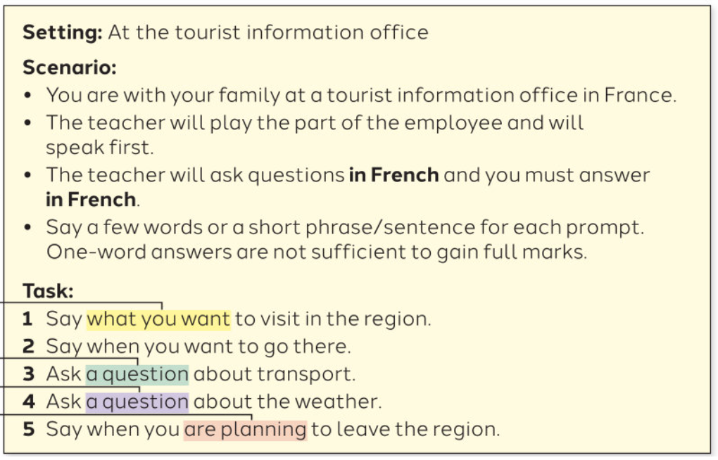
Higher textbook page 152
Instructions: Fill in the table with your own answer in French for prompt 1 to 5
1
2
3
4
5

Slide 31
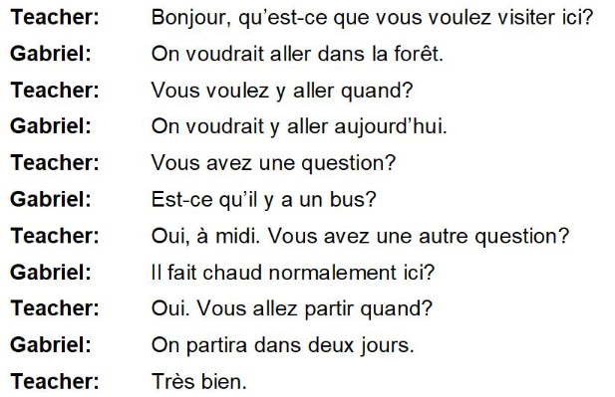

Slide 32
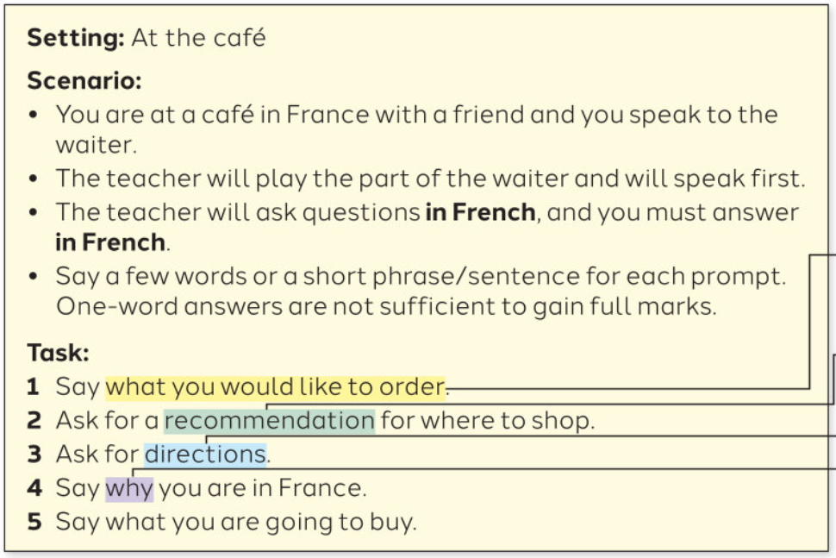
Higher textbook page 176
Instructions: Fill in the table with your own answer in French for prompt 1 to 5
1
2
3
4
5

Slide 33
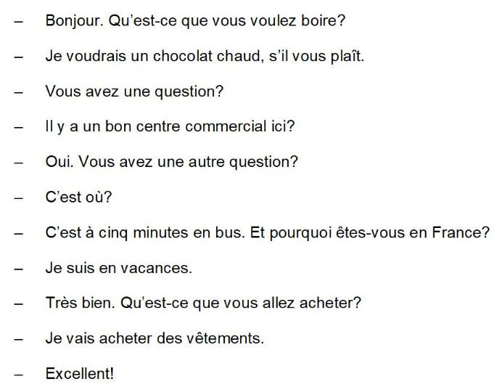

Slide 34
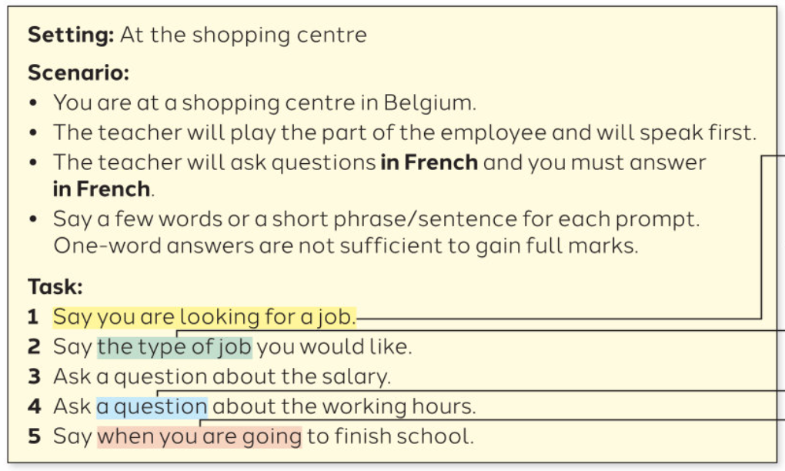
Higher textbook page 198
Instructions: Fill in the table with your own answer in French for prompt 1 to 5
1
2
3
4
5

Slide 35
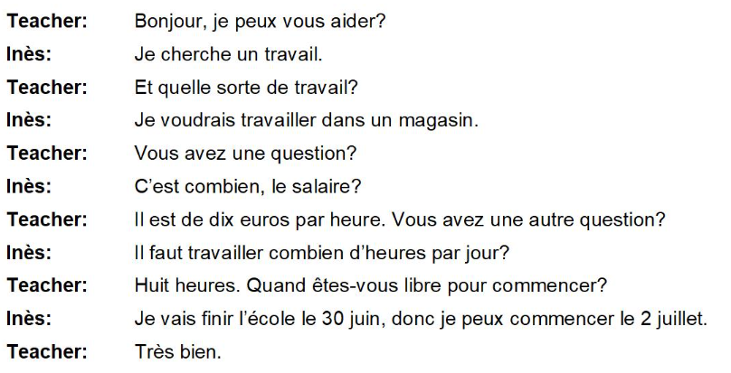

Slide 36
Gold challenge: Write your top 5 higher structures in French
1- ____________________________
2- ____________________________
3- ____________________________
4- ____________________________
5- ____________________________

Slide 37
Task 3: Photo card and follow-on question
12 marks out of 50
Students choose their favourite topic 2 weeks before the exam.
Students must describe a picture, including people, location, activity (8 marks)
2 follow on questions (1 present, 1 past)
Answers must be short and concise (4 marks)
Students can ask the teacher to repeat the question (“Répétez s’il vous plait?”)

Slide 38
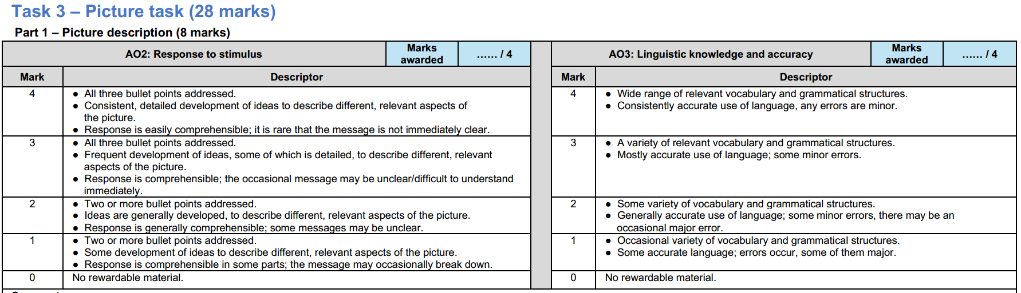

Slide 39
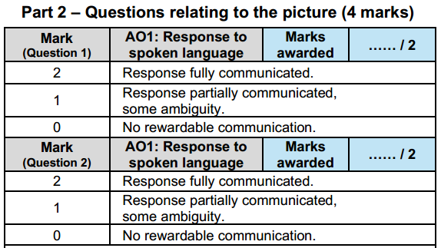

Slide 40
Sur la photo (in the picture) Après avoir analysé la photo (after having analysed the picture) | il y a (there is) on peut voir (we can see) | un homme. (a man) une femme. (a woman) (xx) personnes. un enfant. (a child) un garçon. (a boy) une fille. (a girl) | Ils sont (they are) | dans la cuisine. (in the kitchen) à la maison. (at home) au collège.(at school) dans le parc. au restaurant. au cinéma. |  | Ils discutent. (they are chatting) Ils parlent. (they are talking) Ils jouent. (they are playing) Ils sourient. (they are smiling) Ils rigolent. (they are laughing) Ils mangent. (they are eating)
Il a (he has) Elle a (she has) Ils/elles ont (they have) | les yeux (add colour). les cheveux (add colour). | Il est (he is) Elle est (she is) Ils sont (they are) | grand(s). (tall) petit(s). (short) heureux / contents. (happy)
Au premier plan (on the foreground) À l’arrière-plan (in the background) À gauche (on the left) À droite (on the right) | il y a (there is) on peut voir (we can see) | un tableau. (a board) une table. une télé. des arbres. (trees) | Il porte (he wears) Elle porte (she wears) Ils portent (they wear) Elles portent (they wear) | Une chemise Un t-shirt Un pantalon Un short Une jube | une chemise (a shirt) un t-shirt un pantalon (trousers) un short une jupe (a skirt) | bleu(e) vert(e) rouge gris(e) noir(e) blanc(he) (white)
Il me semble que (it seems to me that) Je dirais que (I would say that) Je crois que (I believe that) | ils s’amusent (they have fun) ils s’ennuient (they are bored) | parce qu’ | ils ont l’air (they seem) |  | heureux. (happy) content(s). (happy)

Slide 41
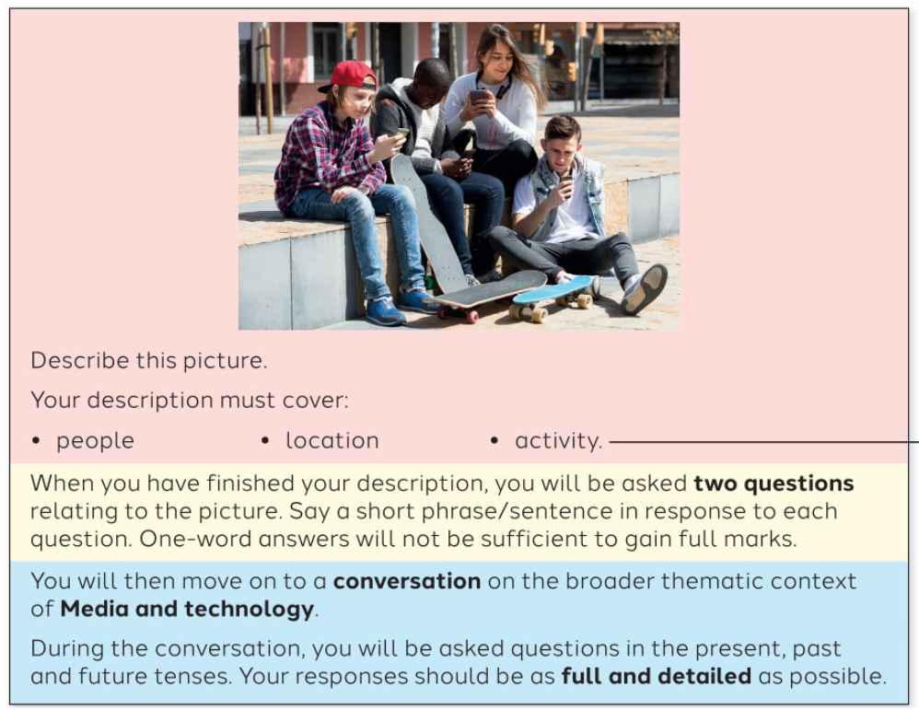
Higher textbook page 26
Photo description
___________________________
___________________________
___________________________
___________________________
___________________________
___________________________
___________________________
___________________________
___________________________
___________________________
___________________________
___________________________
Follow-on questions
Q1: ____________________________________________________________________
A1: ____________________________________________________________________
Q2: ____________________________________________________________________
A2: ____________________________________________________________________

Slide 42
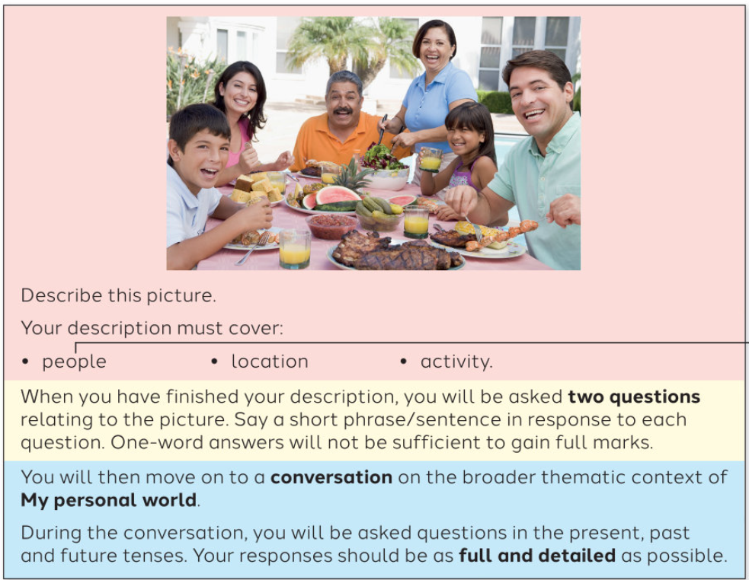
Higher textbook page 50
Photo description
___________________________
___________________________
___________________________
___________________________
___________________________
___________________________
___________________________
___________________________
___________________________
___________________________
___________________________
___________________________
Follow-on questions
Q1: ____________________________________________________________________
A1: ____________________________________________________________________
Q2: ____________________________________________________________________
A2: ____________________________________________________________________

Slide 43
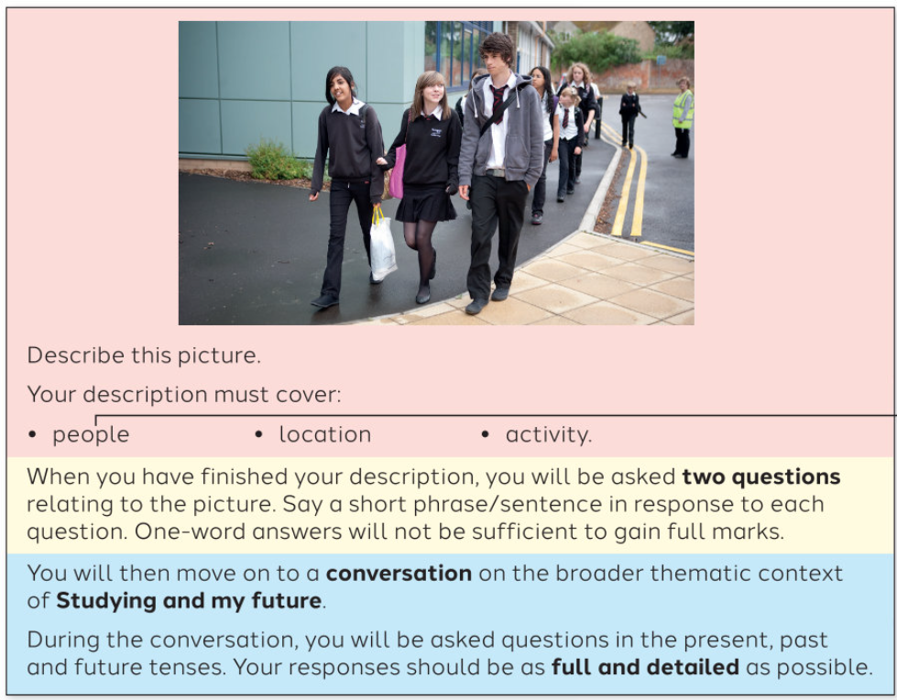
Higher textbook page 76
Photo description
___________________________
___________________________
___________________________
___________________________
___________________________
___________________________
___________________________
___________________________
___________________________
___________________________
___________________________
___________________________
Follow-on questions
Q1: ____________________________________________________________________
A1: ____________________________________________________________________
Q2: ____________________________________________________________________
A2: ____________________________________________________________________

Slide 44
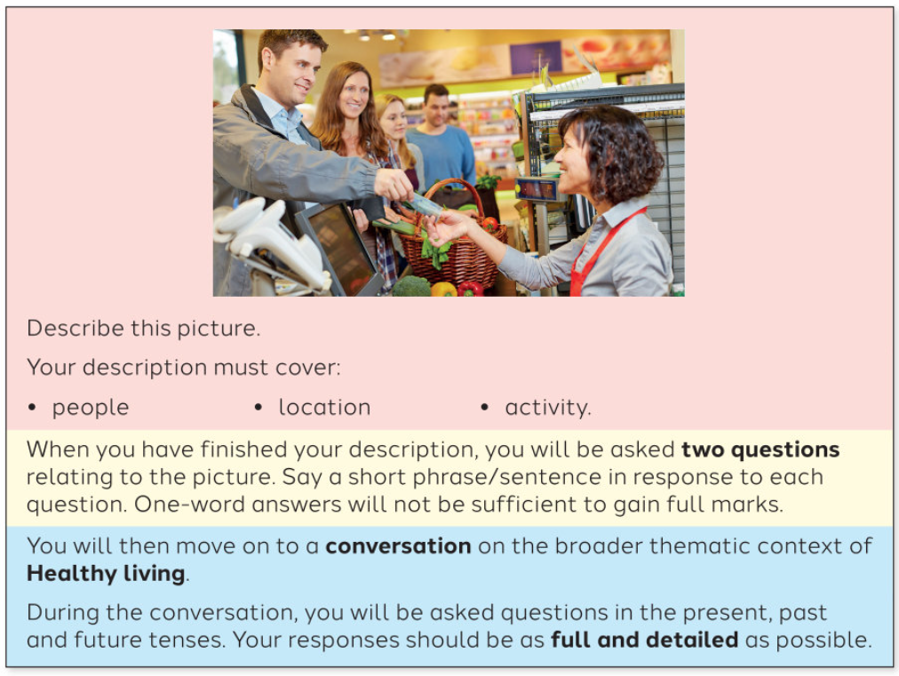
Higher textbook page 100
Photo description
___________________________
___________________________
___________________________
___________________________
___________________________
___________________________
___________________________
___________________________
___________________________
___________________________
___________________________
___________________________
Follow-on questions
Q1: ____________________________________________________________________
A1: ____________________________________________________________________
Q2: ____________________________________________________________________
A2: ____________________________________________________________________

Slide 45
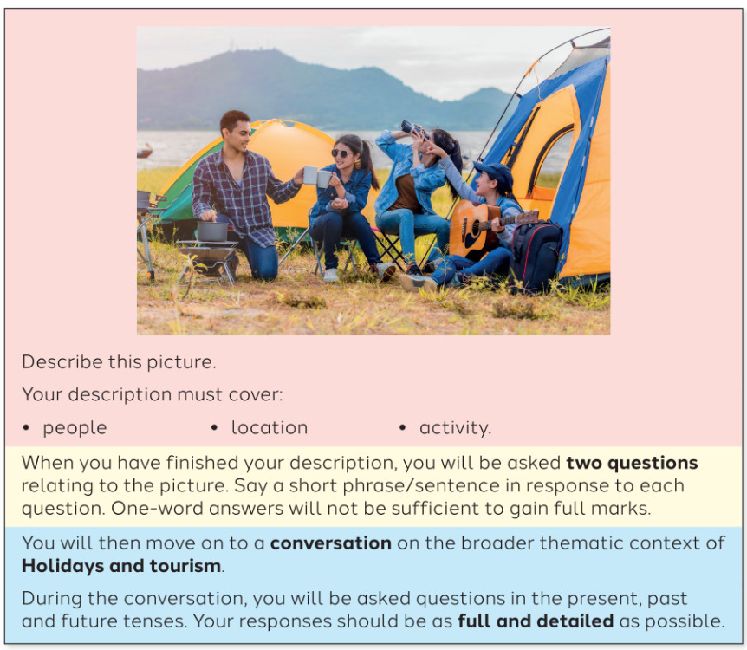
Higher textbook page 125
Photo description
___________________________
___________________________
___________________________
___________________________
___________________________
___________________________
___________________________
___________________________
___________________________
___________________________
___________________________
___________________________
Follow-on questions
Q1: ____________________________________________________________________
A1: ____________________________________________________________________
Q2: ____________________________________________________________________
A2: ____________________________________________________________________

Slide 46
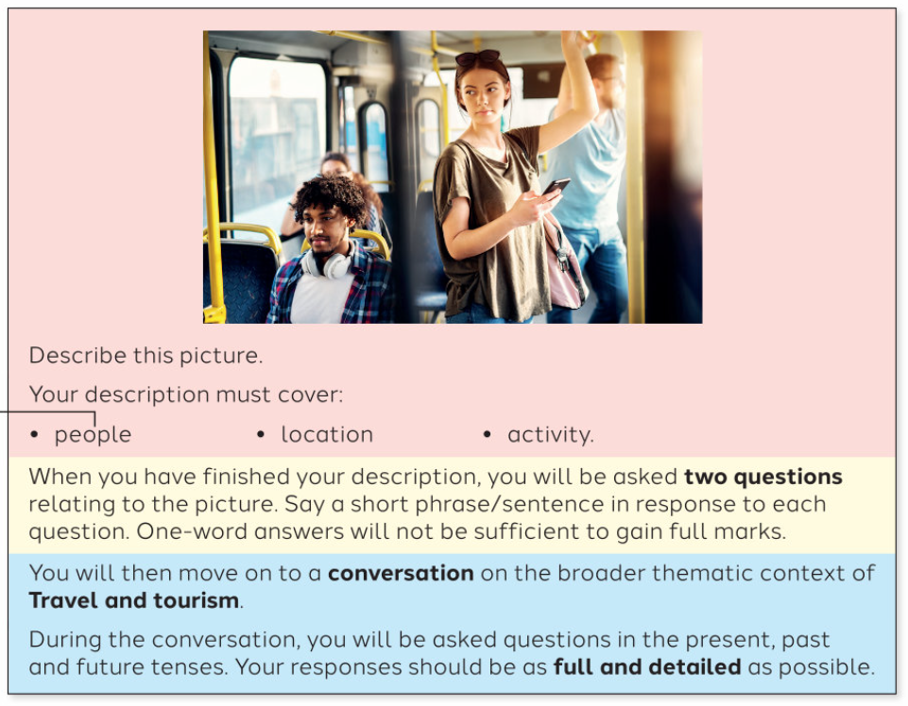
Higher textbook page 153
Photo description
___________________________
___________________________
___________________________
___________________________
___________________________
___________________________
___________________________
___________________________
___________________________
___________________________
___________________________
___________________________
Follow-on questions
Q1: ____________________________________________________________________
A1: ____________________________________________________________________
Q2: ____________________________________________________________________
A2: ____________________________________________________________________

Slide 47
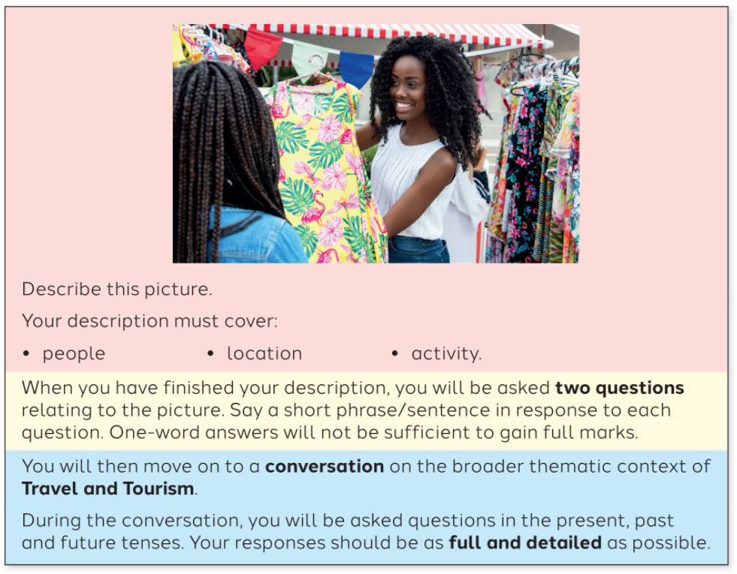
Higher textbook page 177
Photo description
___________________________
___________________________
___________________________
___________________________
___________________________
___________________________
___________________________
___________________________
___________________________
___________________________
___________________________
___________________________
Follow-on questions
Q1: ____________________________________________________________________
A1: ____________________________________________________________________
Q2: ____________________________________________________________________
A2: ____________________________________________________________________

Slide 48
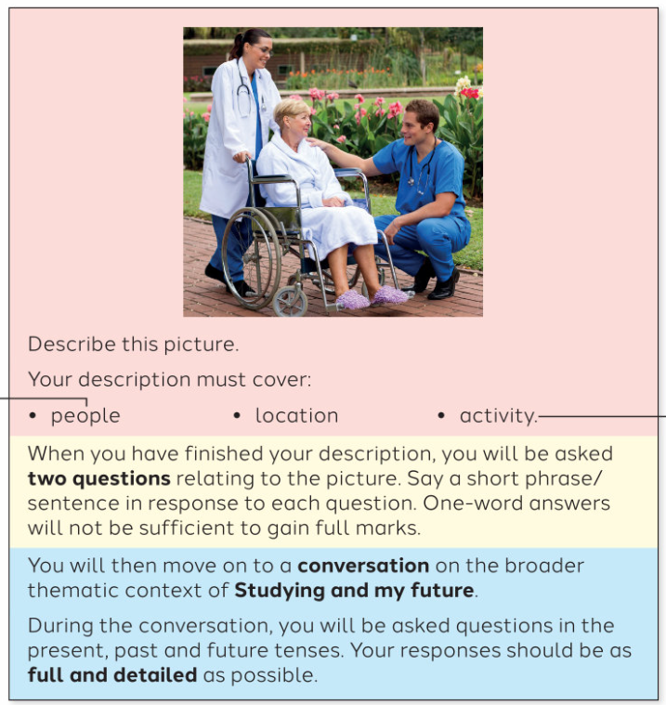
Higher textbook page 199
Photo description
___________________________
___________________________
___________________________
___________________________
___________________________
___________________________
___________________________
___________________________
___________________________
___________________________
___________________________
___________________________
Follow-on questions
Q1: ____________________________________________________________________
A1: ____________________________________________________________________
Q2: ____________________________________________________________________
A2: ____________________________________________________________________

Slide 49
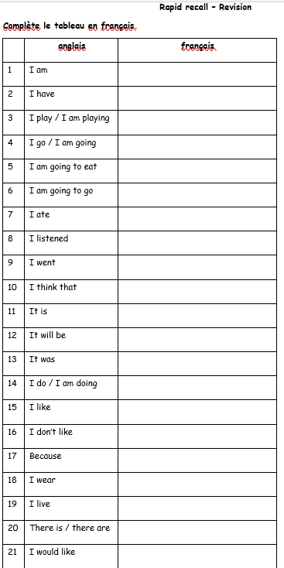
Gold challenge: Write your top 5 higher structures in French
1- ____________________________
2- ____________________________
3- ____________________________
4- ____________________________
5- ____________________________

Slide 50
Task 3: broader conversation
16 marks out of 50
Conversation on a chosen topic, following the picture task
Answers must be very detailed

Slide 51
Which conversation topics have you chosen?
A) Module 1 Family & friends + Module 2 Free time
B) Module 3 School + Module 8 studying and my future
C) Module 4 Healthy lifestyle + Module 2 Free time
D) Module 5 Holidays + Module 2 Free time (or Module 4 healthy lifestyle)
E) Module 6 Environment + Module 7 my neighbourhood

Slide 52
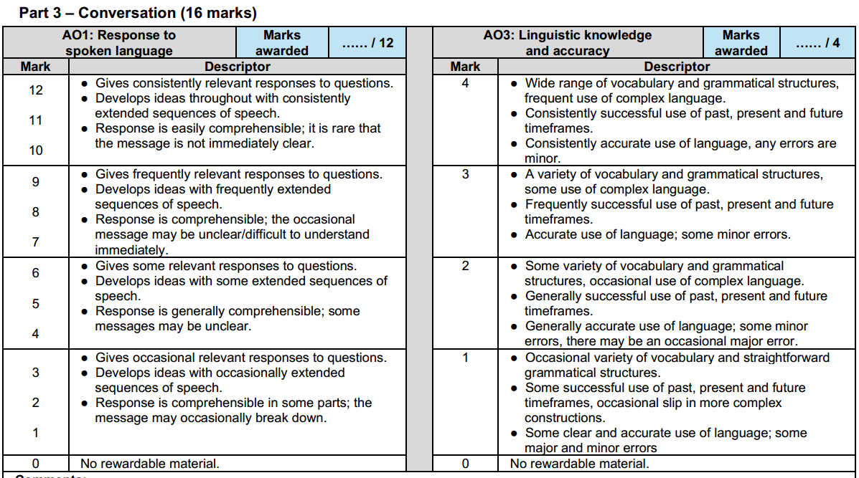

Slide 53
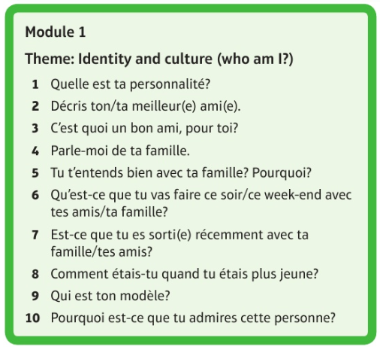
Module 1
Family & friends

Slide 54
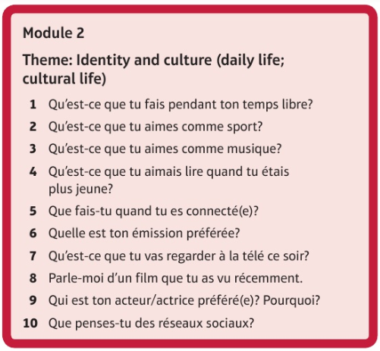
Module 1
Family & friends

Slide 55
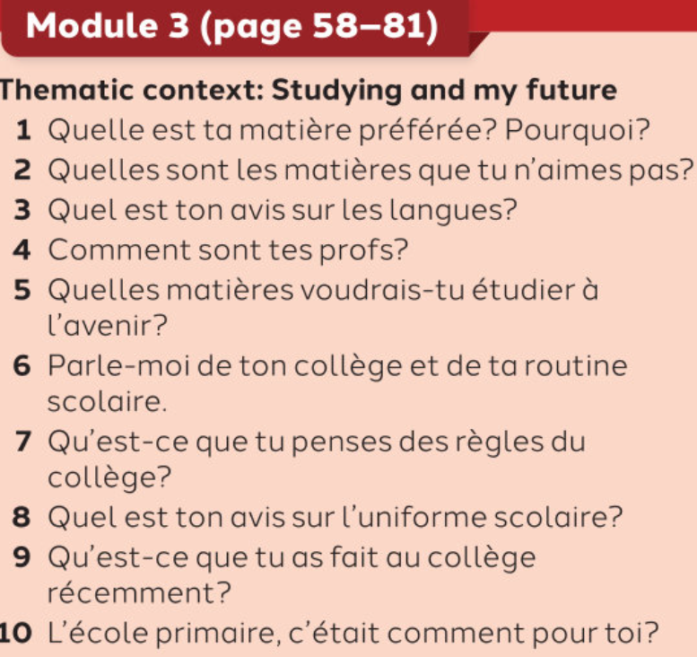
Module 3
school

Slide 56
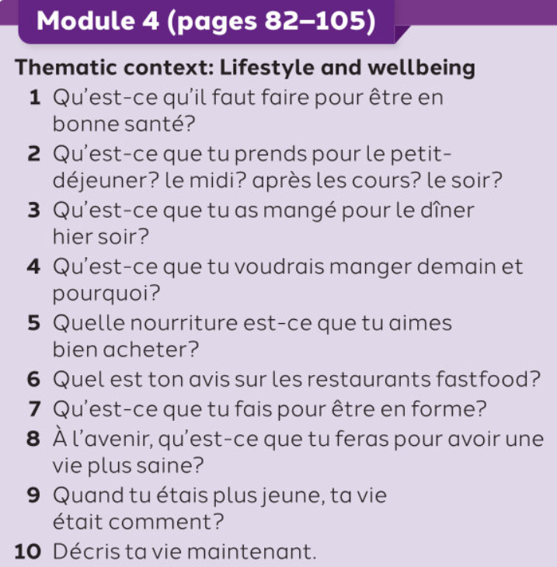
Module 4
Healthy lifestyle

Slide 57
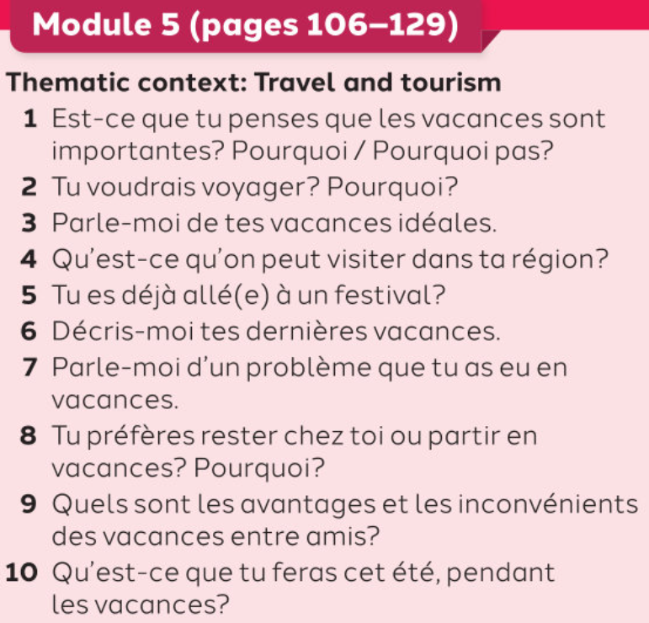
Module 5
Holidays

Slide 58
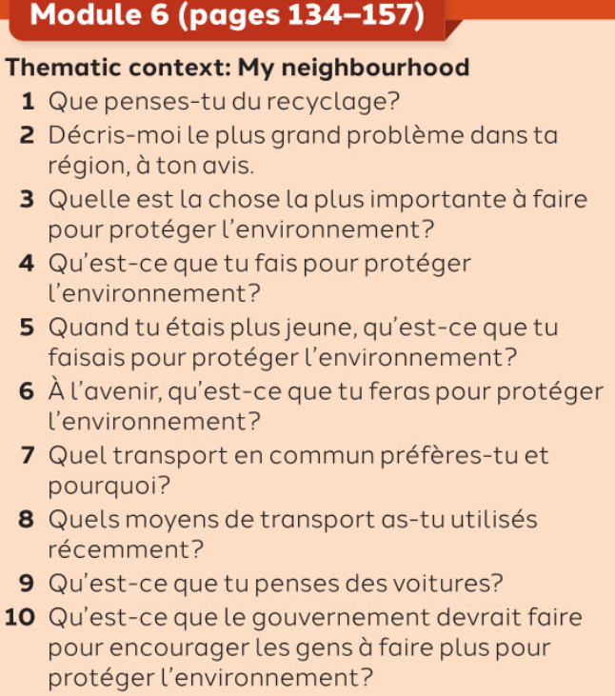
Module 6
Environment

Slide 59
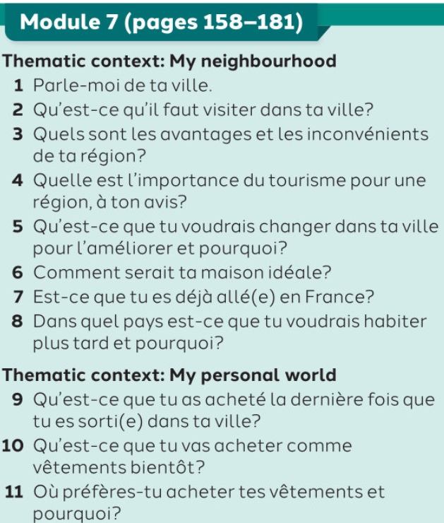
Module 7
My neighbourhood

Slide 60
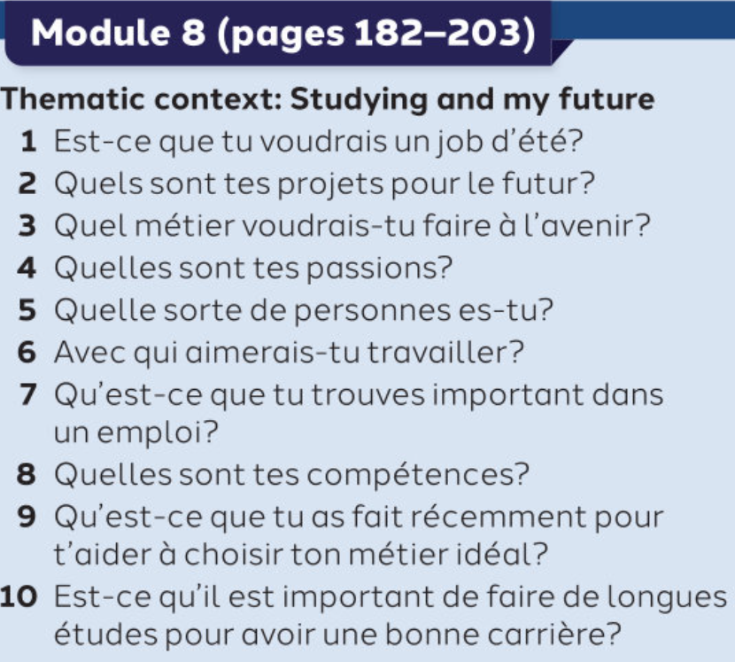
Module 8
Studying and my future

Slide 61
Gold challenge: Write your top 5 higher structures in French
1- ____________________________
2- ____________________________
3- ____________________________
4- ____________________________
5- ____________________________

Slide 62
Extra resources for independent revision
Try these tasks too in order to develop your skills for the speaking trial exams.
You will also find the answers, so that you can self assess.

Slide 63
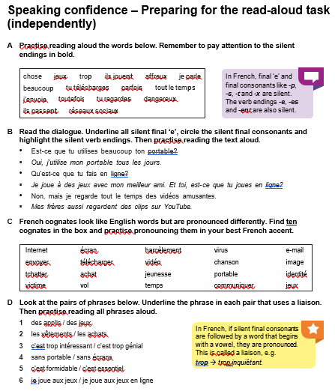
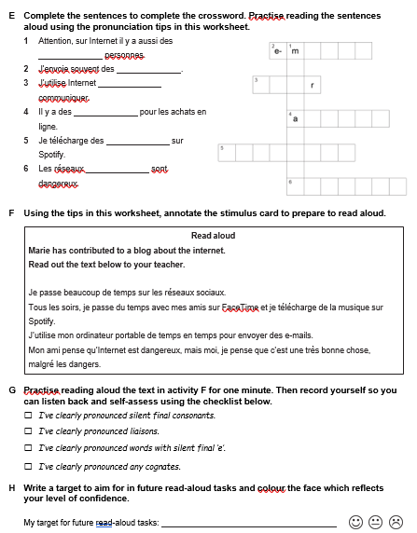

Slide 64


Slide 65



Slide 66


Slide 67



Slide 68


Slide 69



Slide 70


Slide 71



Slide 72


Slide 73



Slide 74


Slide 75



Slide 76


Slide 77



Slide 78


Slide 79



Slide 80


Slide 81


Slide 82


Slide 83


Slide 84


