Slide 1
Year 11 French speaking trial exam revision lessons
Foundation
Independent revision outside of lessons:
Memorise the speaking questions for your chosen topic (Module 1, 2, 3, 4, 5 or 6)
Practise read aloud cards from this booklet
Practice role plays cards from this booklet
Practise photo cards available from this booklet
Record yourself saying your speaking question answers from memory
Listen to French Radio
Watch French programmes on Netflix, Amazon Prime or Channel 4
Little and Often is the key!
All this is on Google Classroom!
When?
w/c 8th Dec (band 1)
w/c 15th Dec (band 2)
Where?
Meeting Room 1 (above Chine)

Slide 2
Choose your conversation topics (16 out of 50 marks)
A) Module 1 Family & friends + Module 2 Free time
B) Module 3 School + Module 8 studying and my future
C) Module 4 Healthy lifestyle + Module 2 Free time
D) Module 5 Holidays + Module 2 Free time (or Module 4 healthy lifestyle)
E) Module 6 Environment + Module 7 my neighbourhood

Slide 3
Choose your conversation theme (16 out of 50 marks)
Theme 1: My personal world (module 1, 2 and 7)
Theme 2: Media and technology (module 2)
Theme 3: Studying and my future (module 3 and 8)
Theme 4: Lifestyle and wellbeing (module 4)
Theme 5: Travel and tourism (module 5)
Theme 6: My neighbourhood (module 6 and module 7)

Slide 4
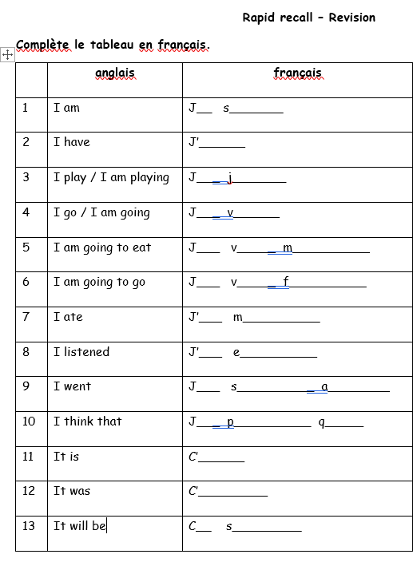
Gold challenge: Write your top 5 higher structures in French
1- ____________________________
2- ____________________________
3- ____________________________
4- ____________________________
5- ____________________________
do

Slide 5
Speaking Foundation (15 mins preparation + 7-9 mins speaking exam)
Arrive on time in Meeting Room 1
Wait for the invigilator to greet you
No phones or any other electronic equipment allowed
Bring a pen
Your teacher will give you the read aloud card, the role play card and the photo card
Prepare notes for the role play card and the photo card (14 mins)
Write notes on the lined paper provided, NOT on the cards.
Enter the exam room with the cards and your notes when told by your teacher
Practice the read aloud task for 1 minute in the exam room.
Start the speaking trial exam

Slide 6
Speaking trial exams (foundation tier)
14-minute preparation in MR1 + 1-minute preparation in exam room
Task 1: read aloud task (approx. 1.5 - 2minutes)
Task 2: role play task (approx. 1 - 1.5 minutes)
Task 3 (based on your chosen topic): - photo task description
- follow on questions (1.5 - 2mins)
- conversation (3 - 3.5mins)

Slide 7
Task 1: read aloud task
Two marks per answer (12 marks out of 50)
Read aloud a short passage in French (35-40 words / 5 sentences)
8 marks
Answer 2 follow-on questions (one like and one opinion)
Answers must short and concise
4 marks

Slide 8
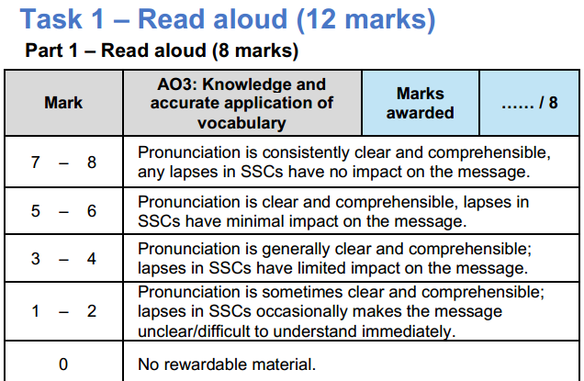
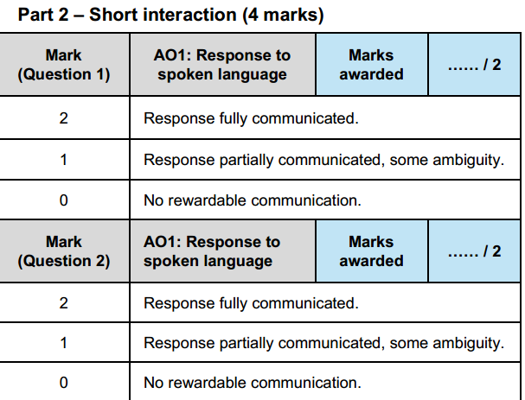

Slide 9
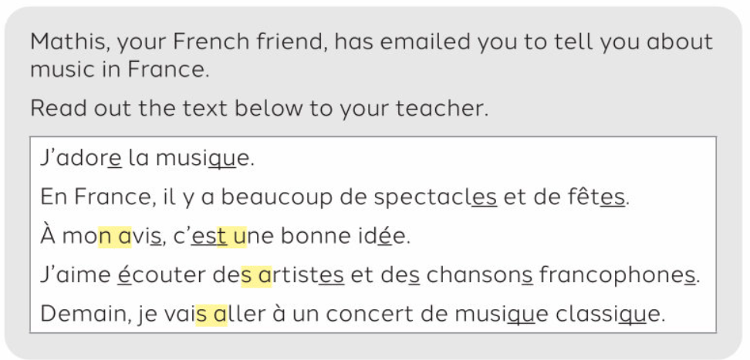
Foundation textbook page 26
Follow-on questions
Q1: ____________________________________________________________________
A1: ____________________________________________________________________
Q2: ____________________________________________________________________
A2: ____________________________________________________________________

Slide 10
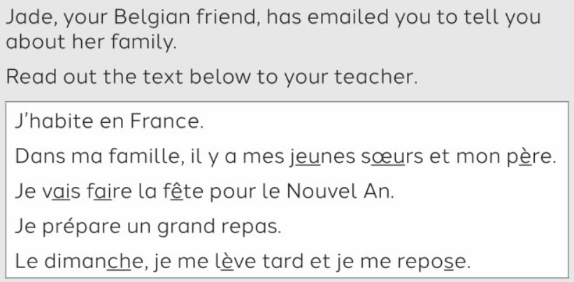
Foundation textbook page 50
Follow-on questions
Q1: ____________________________________________________________________
A1: ____________________________________________________________________
Q2: ____________________________________________________________________
A2: ____________________________________________________________________

Slide 11
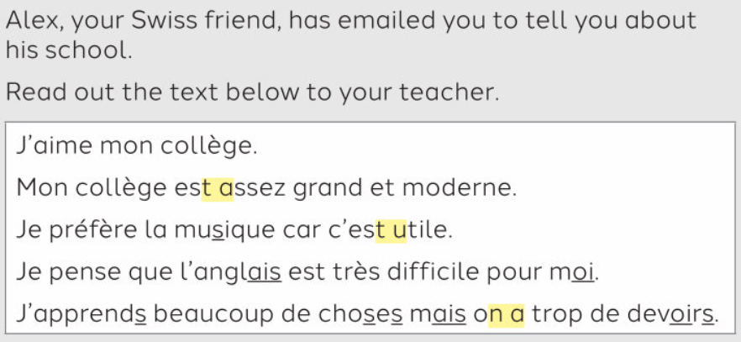
Foundation textbook page 76
Follow-on questions
Q1: ____________________________________________________________________
A1: ____________________________________________________________________
Q2: ____________________________________________________________________
A2: ____________________________________________________________________

Slide 12
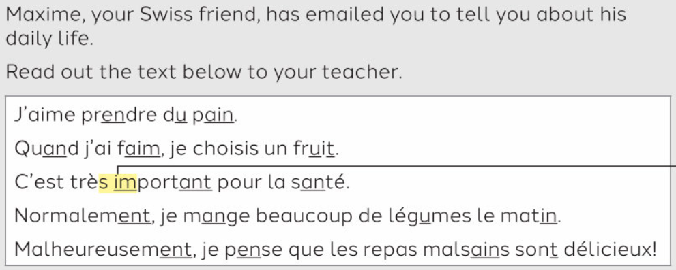
Foundation textbook page 104
Follow-on questions
Q1: ____________________________________________________________________
A1: ____________________________________________________________________
Q2: ____________________________________________________________________
A2: ____________________________________________________________________

Slide 13
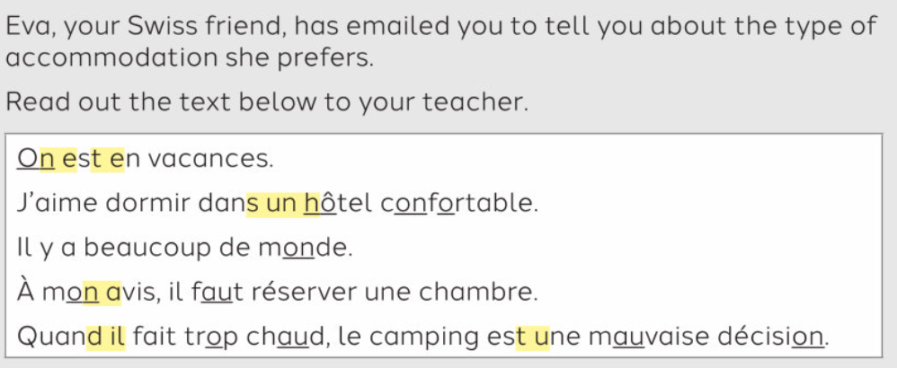
Foundation textbook page 124
Follow-on questions
Q1: ____________________________________________________________________
A1: ____________________________________________________________________
Q2: ____________________________________________________________________
A2: ____________________________________________________________________

Slide 14
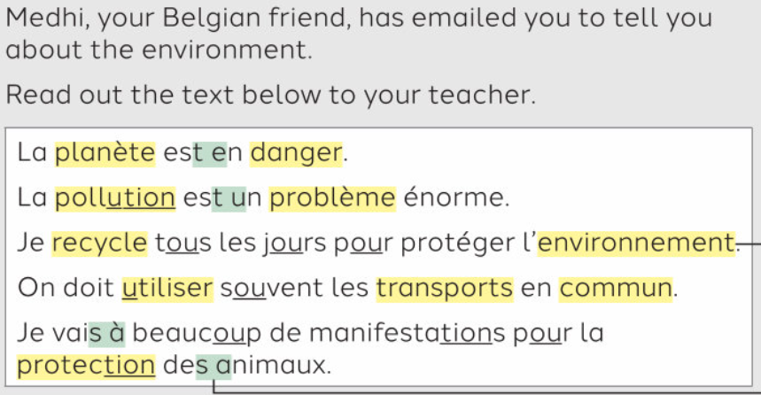
Foundation textbook page 152
Follow-on questions
Q1: ____________________________________________________________________
A1: ____________________________________________________________________
Q2: ____________________________________________________________________
A2: ____________________________________________________________________

Slide 15
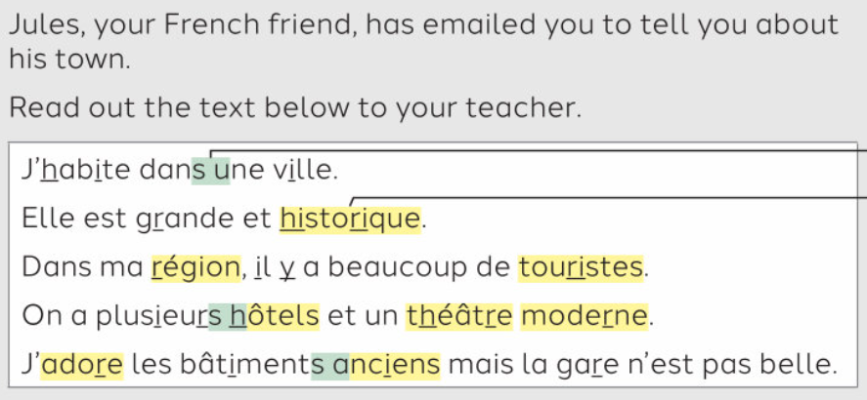
Foundation textbook page 176
Follow-on questions
Q1: ____________________________________________________________________
A1: ____________________________________________________________________
Q2: ____________________________________________________________________
A2: ____________________________________________________________________

Slide 16
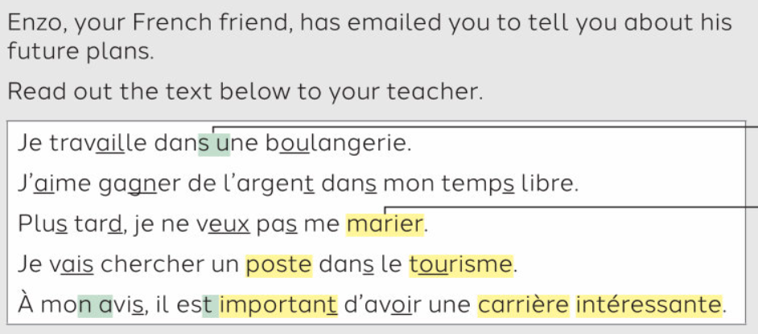
Foundation textbook page 198
Follow-on questions
Q1: ____________________________________________________________________
A1: ____________________________________________________________________
Q2: ____________________________________________________________________
A2: ____________________________________________________________________

Slide 17
Task 2: Role play card
Two marks per answer (10 marks out of 50)
Short answers
Students answer 4 questions.
Answers must short and concise
Students ask 1 question to the examiner
Students can ask the teacher to repeat the question (“Répétez s’il vous plait?”)
Teachers can not change the wording of the questions

Slide 18
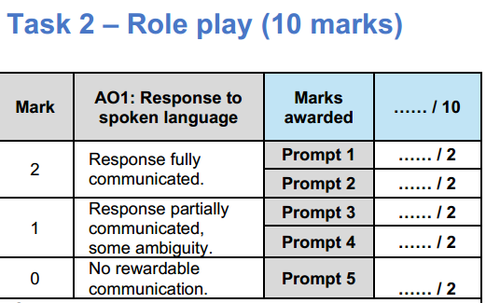

Slide 19
Role play key phrases
1 | I would like | Je voudrais
2 | I like | J’aime
3 | Because | Parce que
4 | I went | Je suis allé
5 | I did | J’ai fait
6 | I ate | J’ai mangé
7 | Is there? | Il y a ?
8 | Can I? | Je peux?
9 | Where is? | Où est?
10 | Where are? | Où sont?
11 | What do you think of? | Qu’est-ce que tu penses?
12 | Do you like? | Tu aimes?

Slide 20
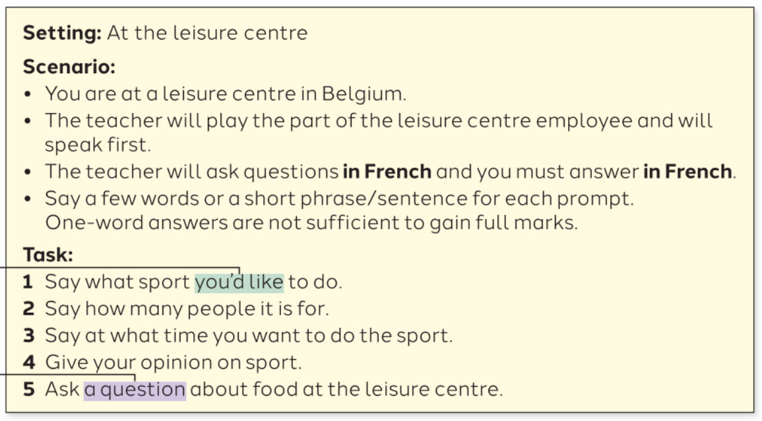
Foundation textbook page 26
Instructions: Fill in the table with your own answer in French for prompt 1 to 5
1
2
3
4
5

Slide 21
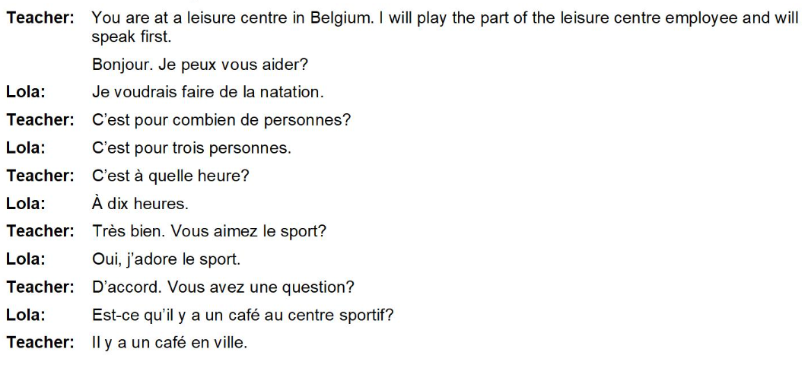

Slide 22
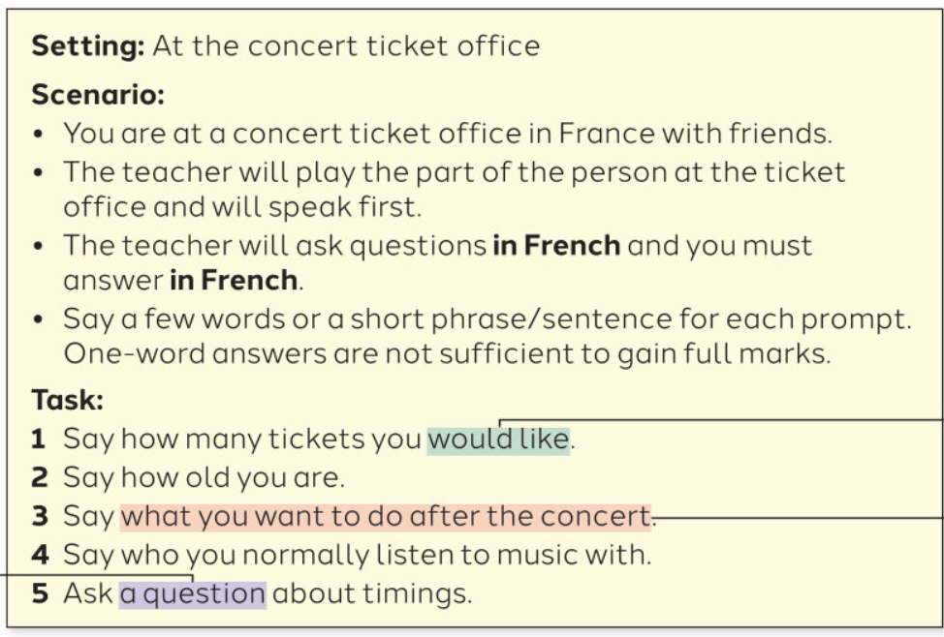
Foundation textbook page 50
Instructions: Fill in the table with your own answer in French for prompt 1 to 5
1
2
3
4
5

Slide 23
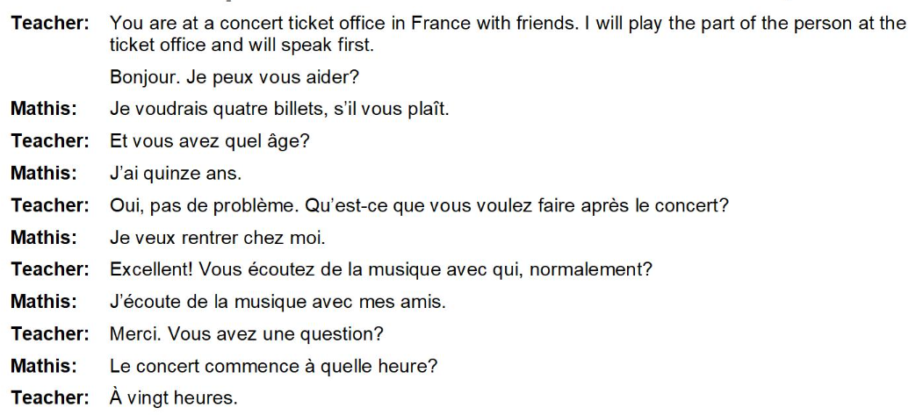

Slide 24
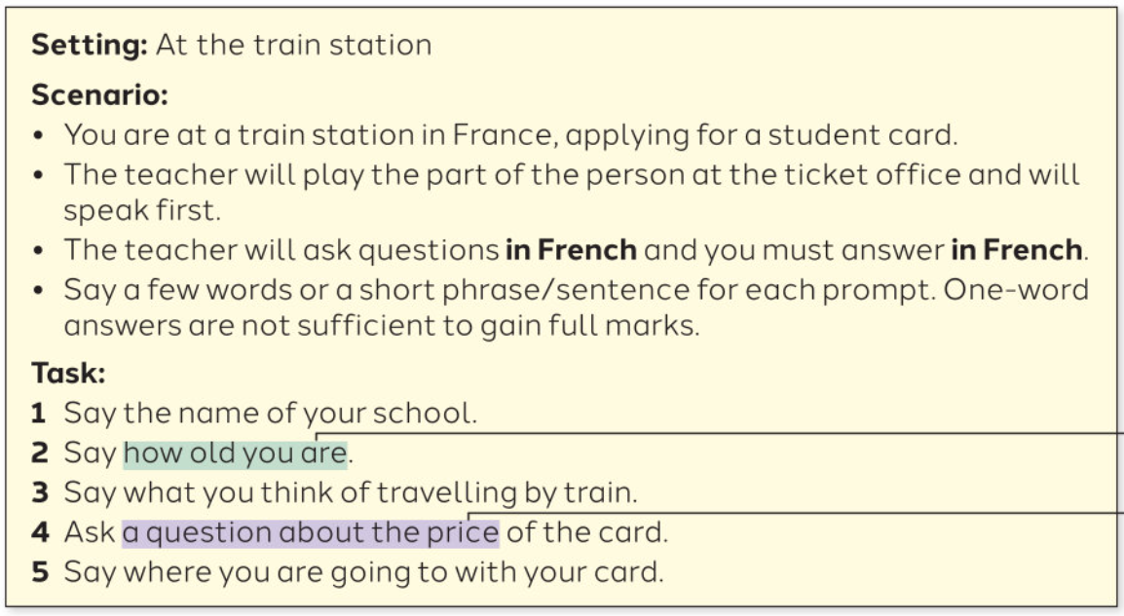
Foundation textbook page 76
Instructions: Fill in the table with your own answer in French for prompt 1 to 5
1
2
3
4
5

Slide 25
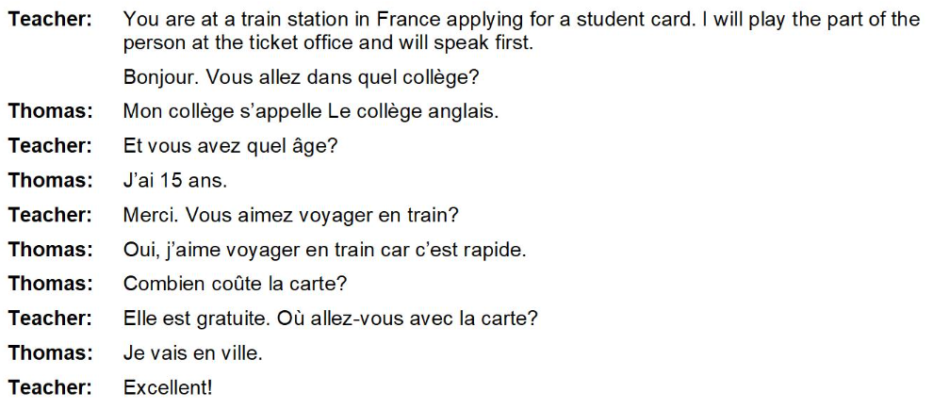

Slide 26
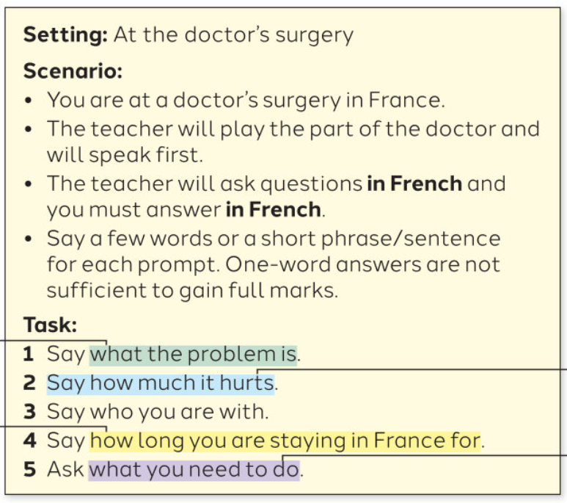
Foundation textbook page 104
Instructions: Fill in the table with your own answer in French for prompt 1 to 5
1
2
3
4
5

Slide 27
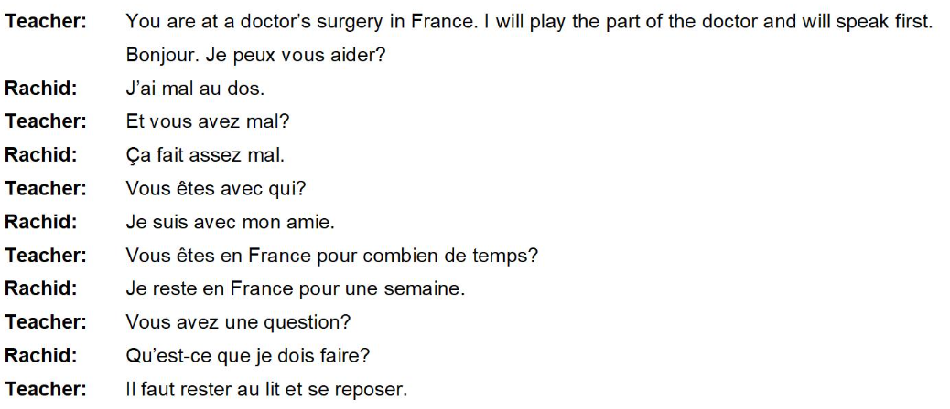

Slide 28
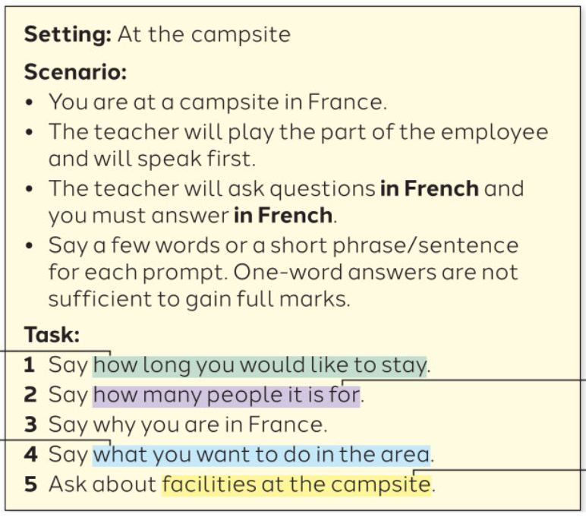
Foundation textbook page 124
Instructions: Fill in the table with your own answer in French for prompt 1 to 5
1
2
3
4
5

Slide 29
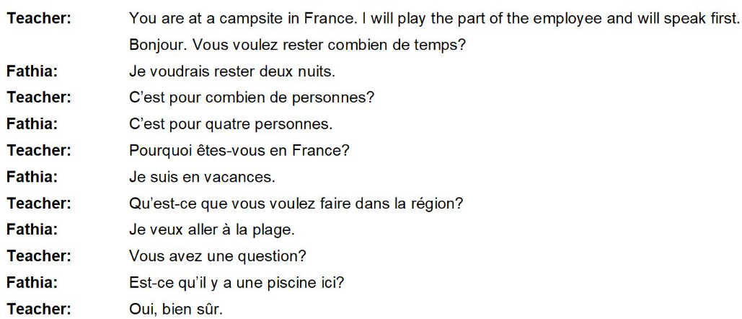

Slide 30
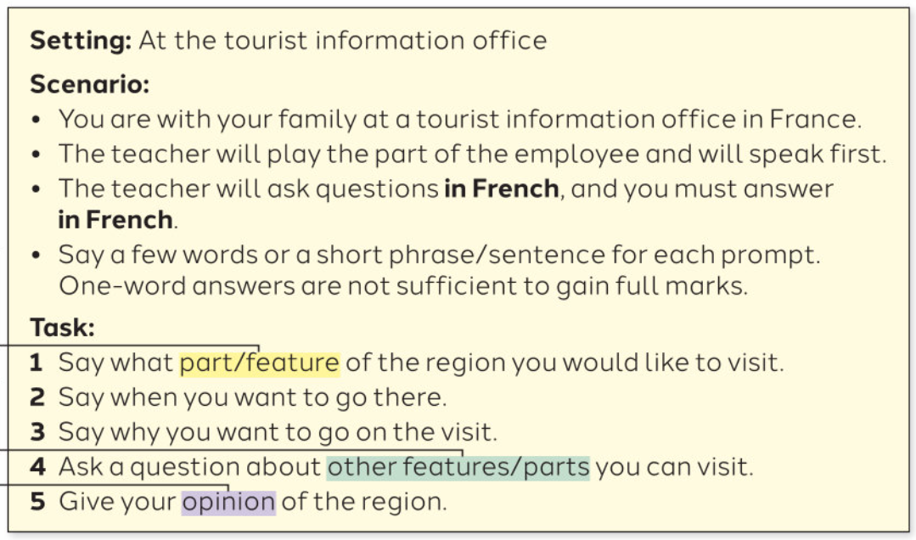
Foundation textbook page 152
Instructions: Fill in the table with your own answer in French for prompt 1 to 5
1
2
3
4
5

Slide 31
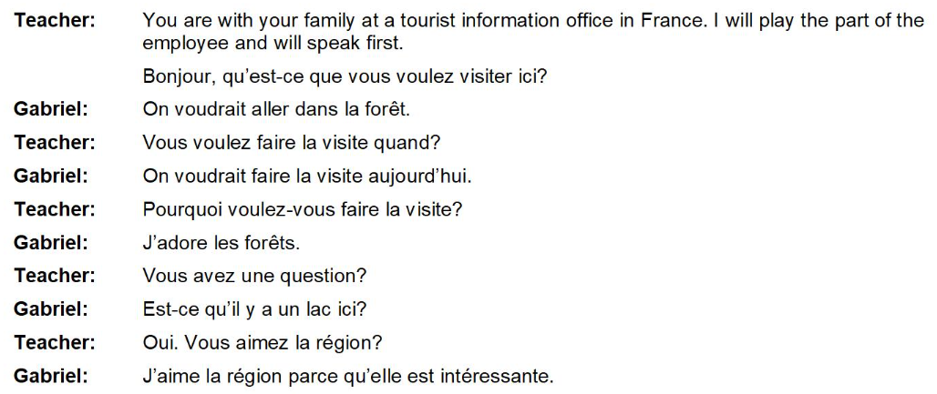

Slide 32
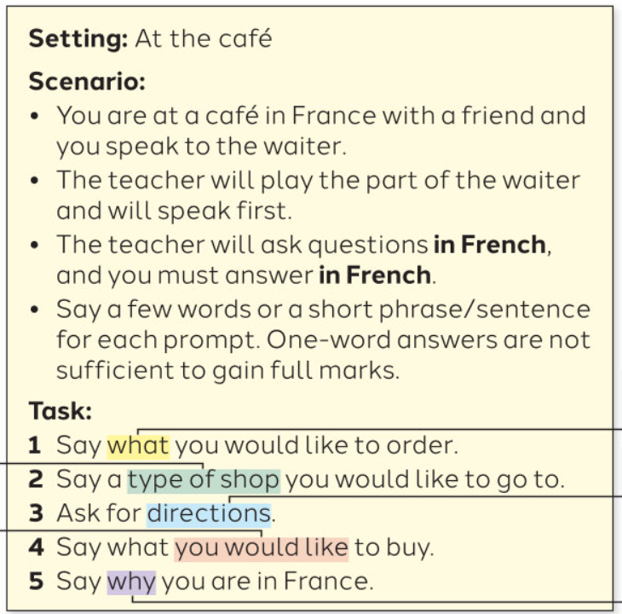
Foundation textbook page 176
Instructions: Fill in the table with your own answer in French for prompt 1 to 5
1
2
3
4
5

Slide 33
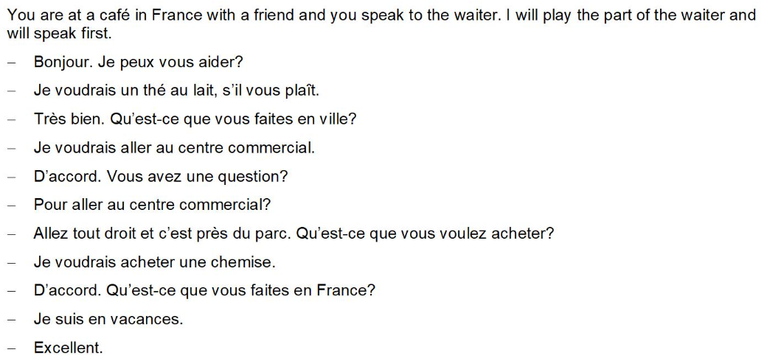

Slide 34
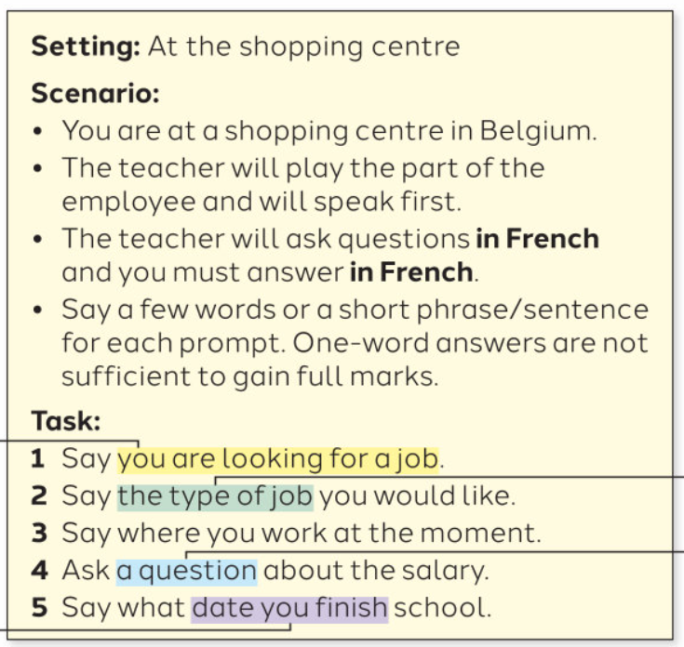
Foundation textbook page 198
Instructions: Fill in the table with your own answer in French for prompt 1 to 5
1
2
3
4
5

Slide 35
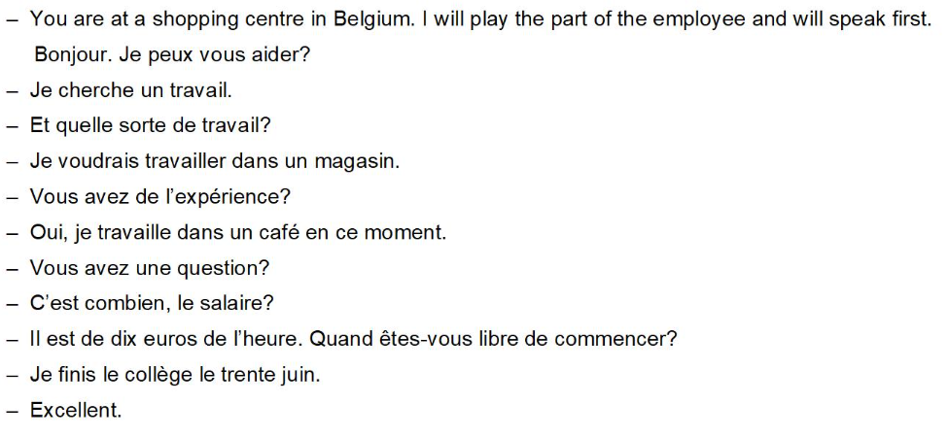

Slide 36
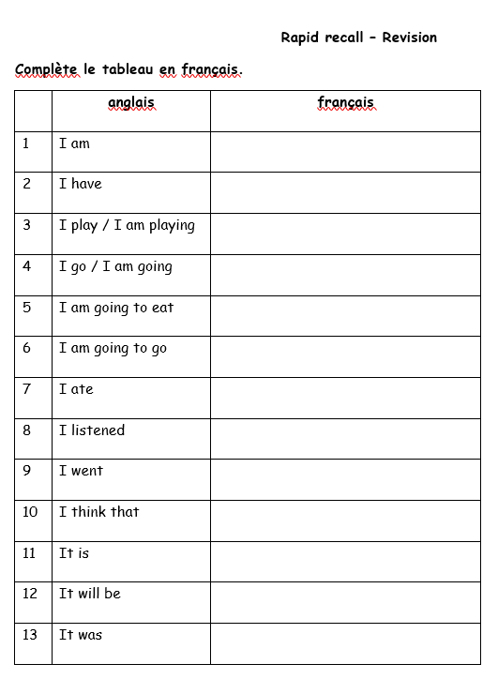
Gold challenge: Write your top 5 higher structures in French
1- ____________________________
2- ____________________________
3- ____________________________
4- ____________________________
5- ____________________________

Slide 37
Task 3: Photo card and follow-on question
12 marks out of 50
Students choose their favourite topic 2 weeks before the exam.
Students must describe a picture, including people, location, activity (8 marks)
2 follow on questions (present or simple conditional)
Answers must be short and concise (4 marks)
Students can ask the teacher to repeat the question (“Répétez s’il vous plait?”)

Slide 38
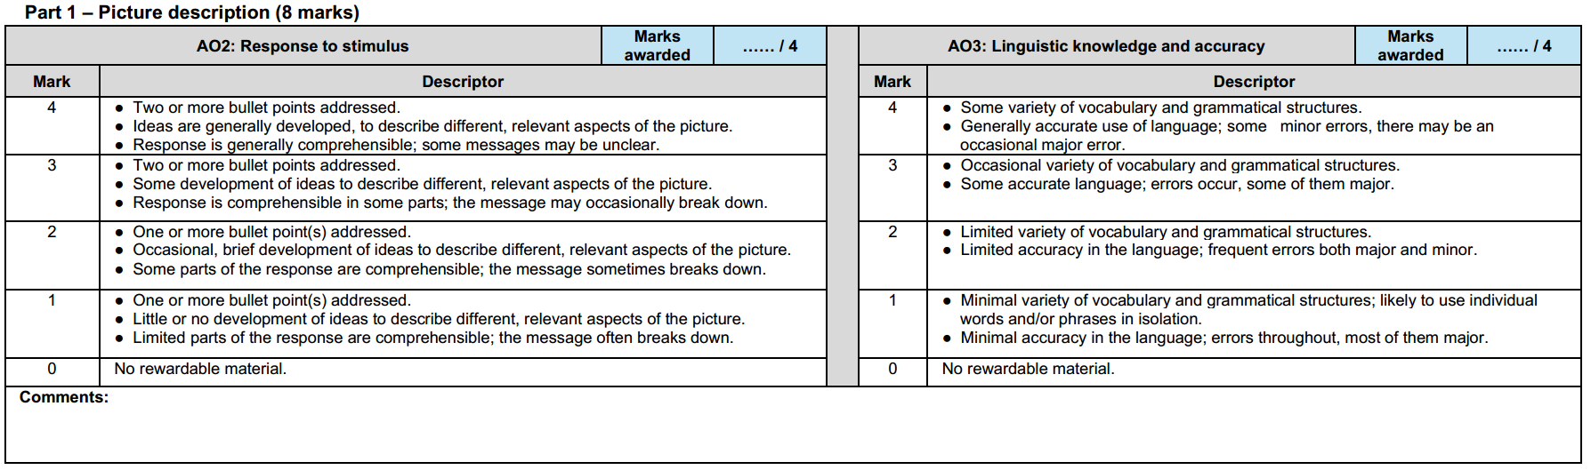

Slide 39
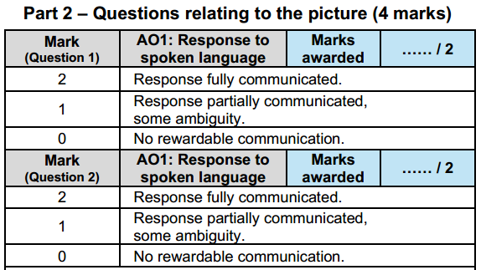

Slide 40
Sur la photo (in the picture) | il y a (there is) | un homme. (a man) une femme. (a woman) (xx) personnes. un enfant. (a child) un garçon. (a boy) une fille. (a girl) | Ils sont (they are) | dans la cuisine. (in the kitchen) à la maison. (at home) au collège.(at school) dans le parc. au restaurant. au cinéma. |  | Ils discutent. (they are chatting) Ils parlent. (they are talking) Ils jouent. (they are playing) Ils sourient. (they are smiling) Ils mangent. (they are eating)
Il a (he has) Elle a (she has) Ils ont (they have) Elles ont (they have) | les yeux (add colour). les cheveux (add colour). | Il est (he is) Elle est (she is) Ils sont (they are) Elles sont (they are) | grand(s). (tall) petit(s). (short) heureux. (happy) contents. (happy)
Au premier plan (on the foreground) À l’arrière-plan (in the background) À gauche (on the left) À droite (on the right) Il me semble qu’ (It seems to me that) | il y a (there is) | un tableau. (a board) une table. une télé. des arbres. (trees) | Il porte (he wears) Elle porte (she wears) Ils portent (they wear) Elles portent (they wear) | Une chemise Un t-shirt Un pantalon Un short Une jube | une chemise (a shirt) un t-shirt un pantalon (trousers) un short une jupe (a skirt) | bleu(e) vert(e) rouge gris(e) noir(e) blanc(he) (white)

Slide 41
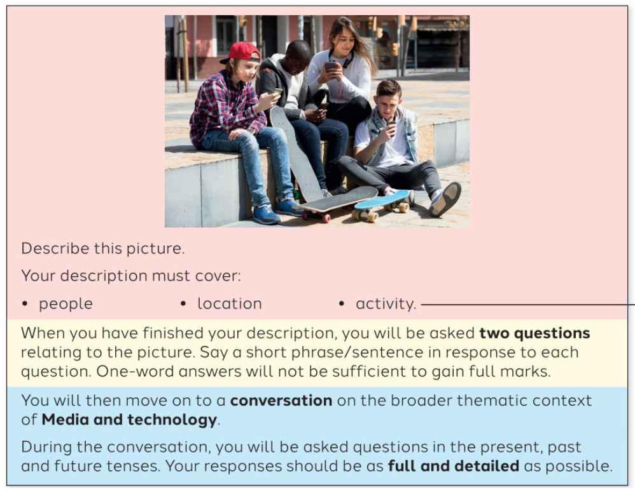
Foundation textbook page 26
Photo description
___________________________
___________________________
___________________________
___________________________
___________________________
___________________________
___________________________
___________________________
___________________________
___________________________
___________________________
___________________________
Follow-on questions
Q1: ____________________________________________________________________
A1: ____________________________________________________________________
Q2: ____________________________________________________________________
A2: ____________________________________________________________________

Slide 42
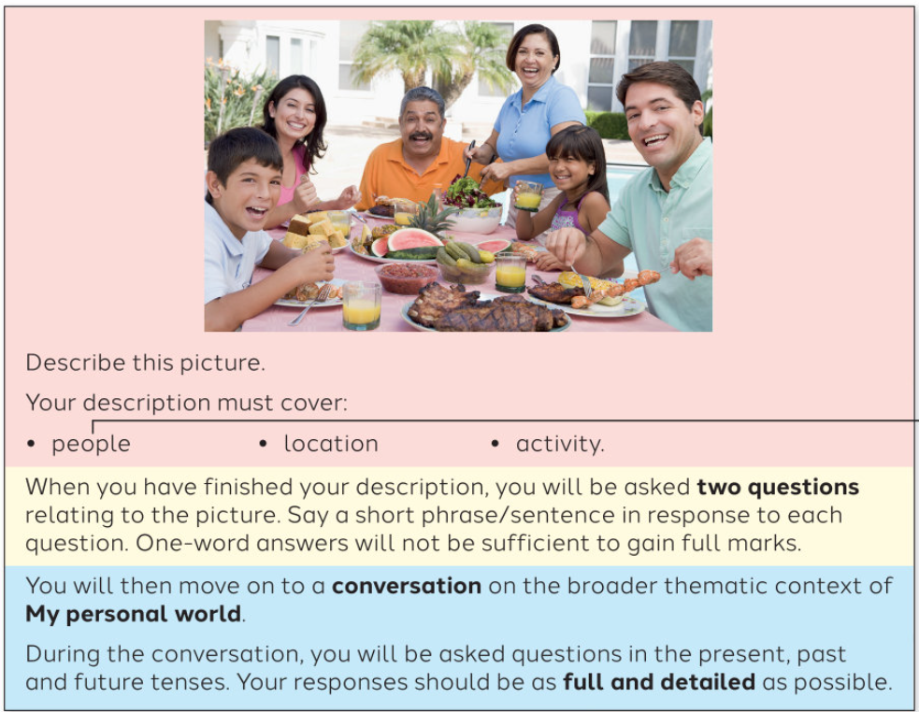
Foundation textbook page 50
Photo description
___________________________
___________________________
___________________________
___________________________
___________________________
___________________________
___________________________
___________________________
___________________________
___________________________
___________________________
___________________________
Follow-on questions
Q1: ____________________________________________________________________
A1: ____________________________________________________________________
Q2: ____________________________________________________________________
A2: ____________________________________________________________________

Slide 43
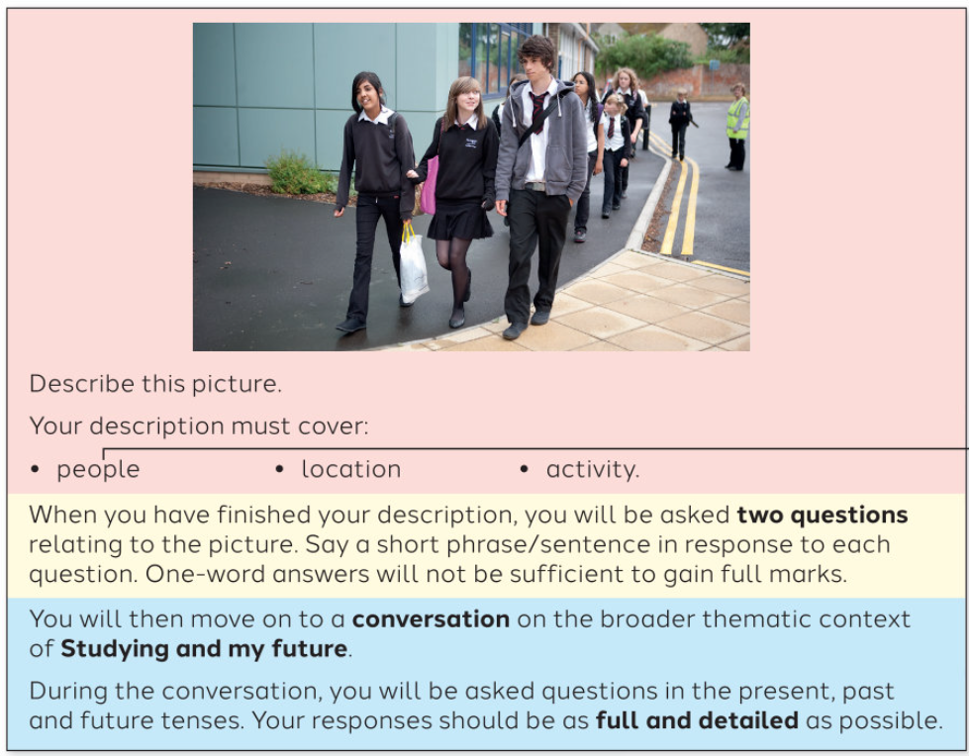
Foundation textbook page 76
Photo description
___________________________
___________________________
___________________________
___________________________
___________________________
___________________________
___________________________
___________________________
___________________________
___________________________
___________________________
___________________________
Follow-on questions
Q1: ____________________________________________________________________
A1: ____________________________________________________________________
Q2: ____________________________________________________________________
A2: ____________________________________________________________________

Slide 44
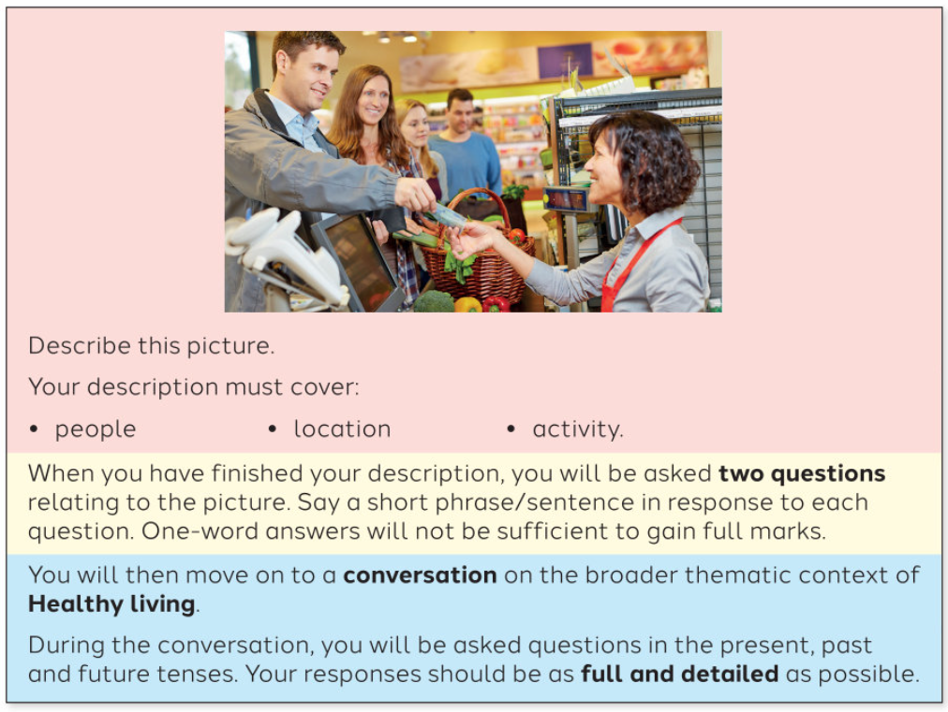
Foundation textbook page 100
Photo description
___________________________
___________________________
___________________________
___________________________
___________________________
___________________________
___________________________
___________________________
___________________________
___________________________
___________________________
___________________________
Follow-on questions
Q1: ____________________________________________________________________
A1: ____________________________________________________________________
Q2: ____________________________________________________________________
A2: ____________________________________________________________________

Slide 45
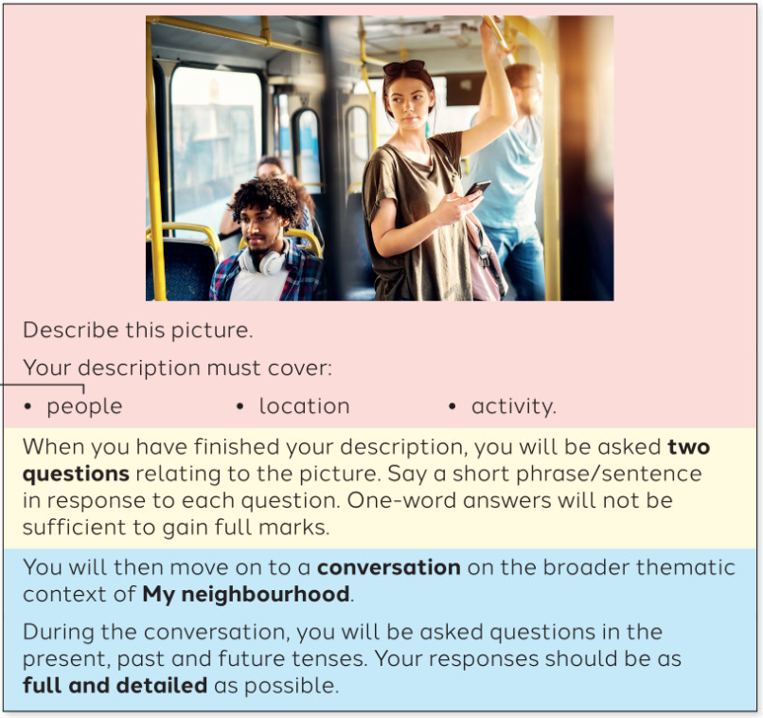
Foundation textbook page 153
Photo description
___________________________
___________________________
___________________________
___________________________
___________________________
___________________________
___________________________
___________________________
___________________________
___________________________
___________________________
___________________________
Follow-on questions
Q1: ____________________________________________________________________
A1: ____________________________________________________________________
Q2: ____________________________________________________________________
A2: ____________________________________________________________________

Slide 46
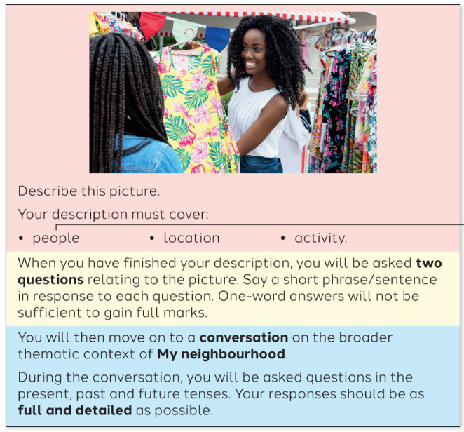
Foundation textbook page 177
Photo description
___________________________
___________________________
___________________________
___________________________
___________________________
___________________________
___________________________
___________________________
___________________________
___________________________
___________________________
___________________________
Follow-on questions
Q1: ____________________________________________________________________
A1: ____________________________________________________________________
Q2: ____________________________________________________________________
A2: ____________________________________________________________________

Slide 47
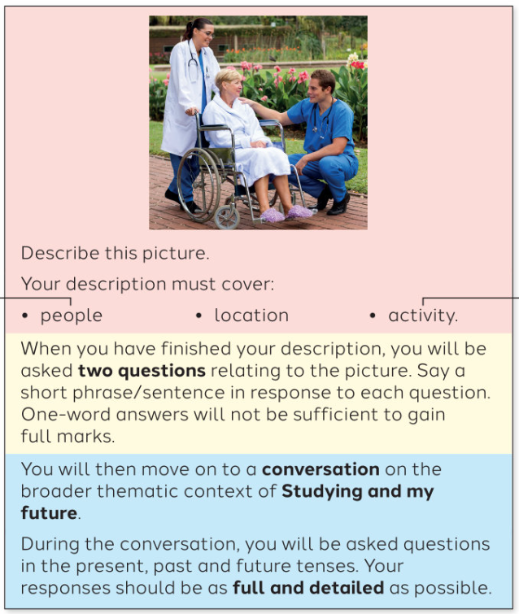
Foundation textbook page 199
Photo description
___________________________
___________________________
___________________________
___________________________
___________________________
___________________________
___________________________
___________________________
___________________________
___________________________
___________________________
___________________________
Follow-on questions
Q1: ____________________________________________________________________
A1: ____________________________________________________________________
Q2: ____________________________________________________________________
A2: ____________________________________________________________________

Slide 48
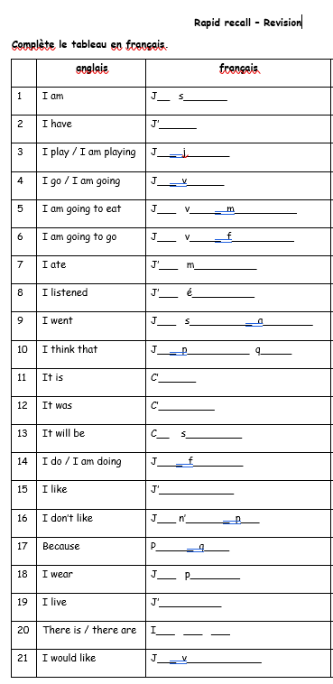
Gold challenge: Write your top 5 higher structures in French
1- ____________________________
2- ____________________________
3- ____________________________
4- ____________________________
5- ____________________________
a

Slide 49
Task 3: broader conversation
16 marks out of 50
Conversation on a chosen topic, following the picture task
Answers must be very detailed

Slide 50
Which conversation topics have you chosen?
A) Module 1 Family & friends + Module 2 Free time
B) Module 3 School + Module 8 studying and my future
C) Module 4 Healthy lifestyle + Module 2 Free time
D) Module 5 Holidays + Module 2 Free time (or Module 4 healthy lifestyle)
E) Module 6 Environment + Module 7 my neighbourhood

Slide 51
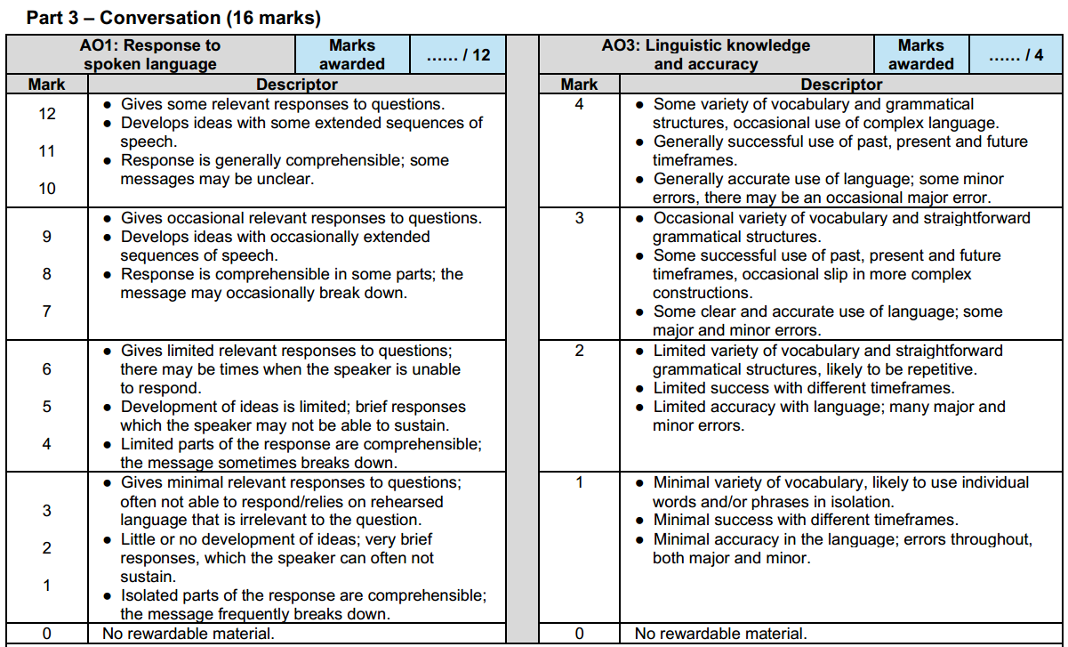

Slide 52
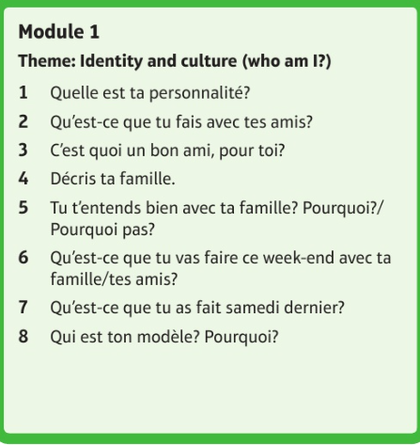
Module 1
Family & friends

Slide 53
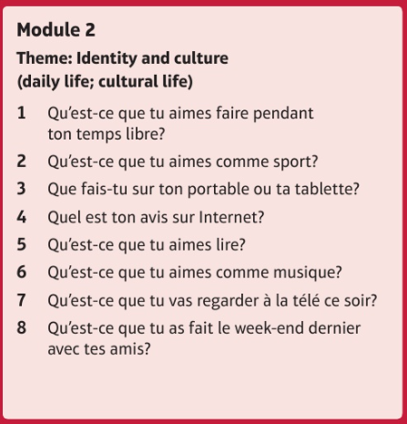
Module 2
Free time

Slide 54
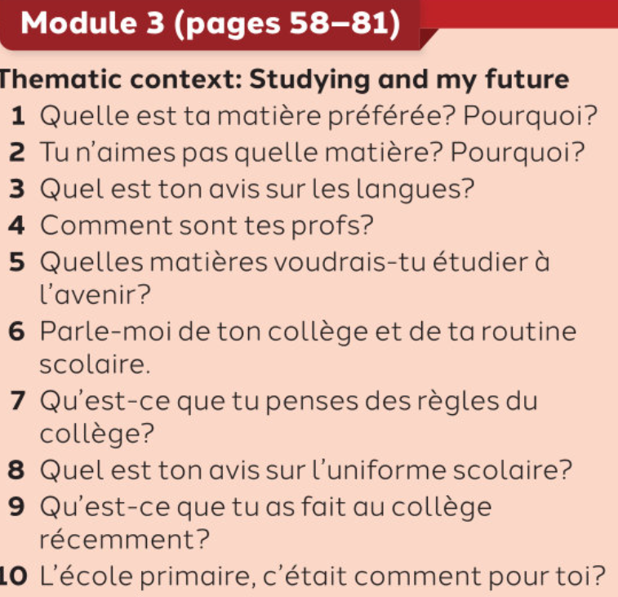
Module 3
school

Slide 55
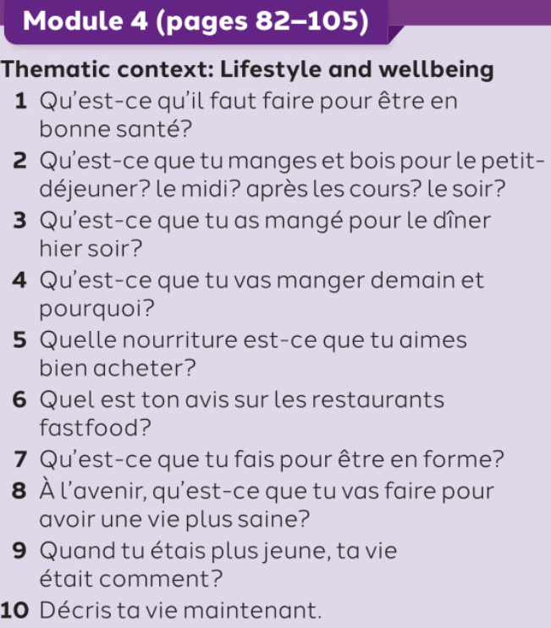
Module 4
Healthy lifestyle

Slide 56
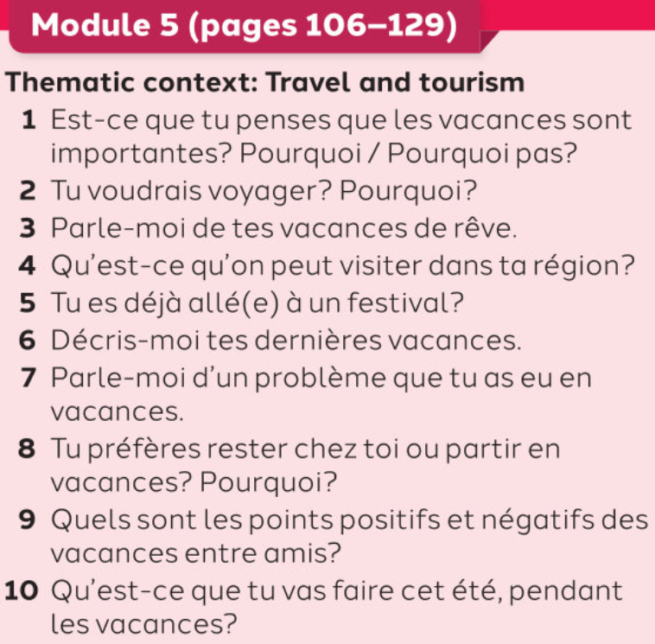
Module 5
Holidays

Slide 57
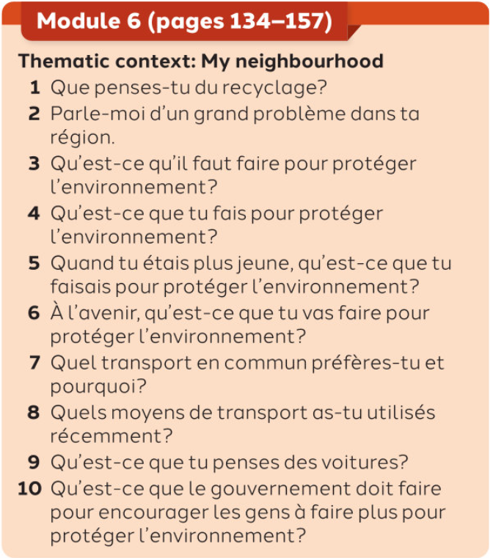
Module 6
Environment

Slide 58
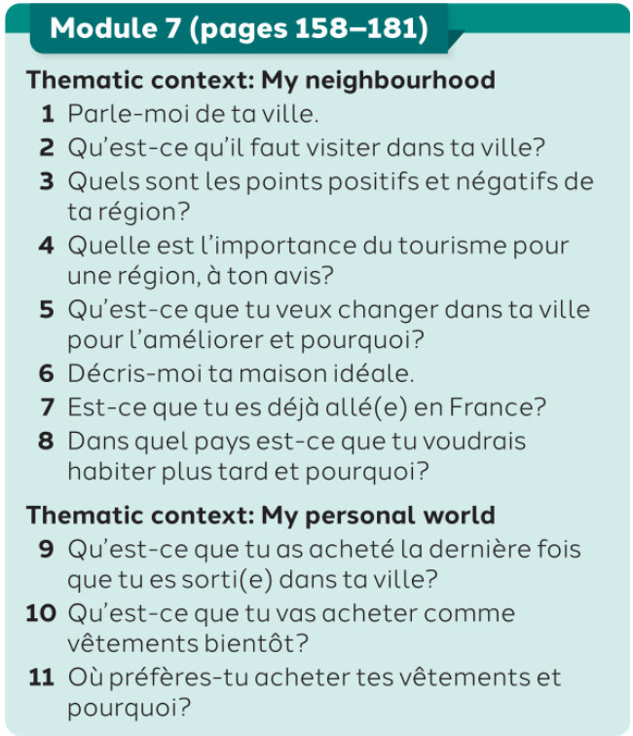
Module 7
My neighbourhood

Slide 59
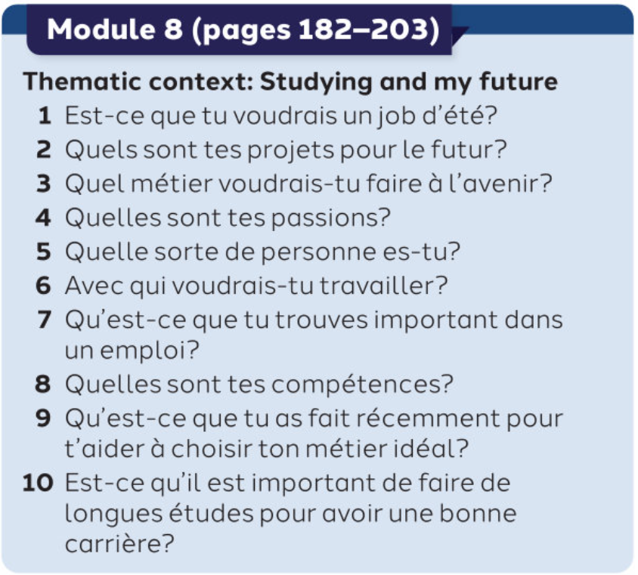
Module 8
Studying and my future

Slide 60
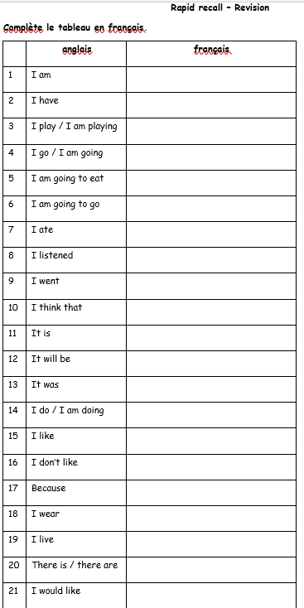
Gold challenge: Write your top 5 higher structures in French
1- ____________________________
2- ____________________________
3- ____________________________
4- ____________________________
5- ____________________________

Slide 61
Extra resources for independent revision
Try these tasks too in order to develop your skills for the speaking trial exams.
You will also find the answers, so that you can self assess.

Slide 62
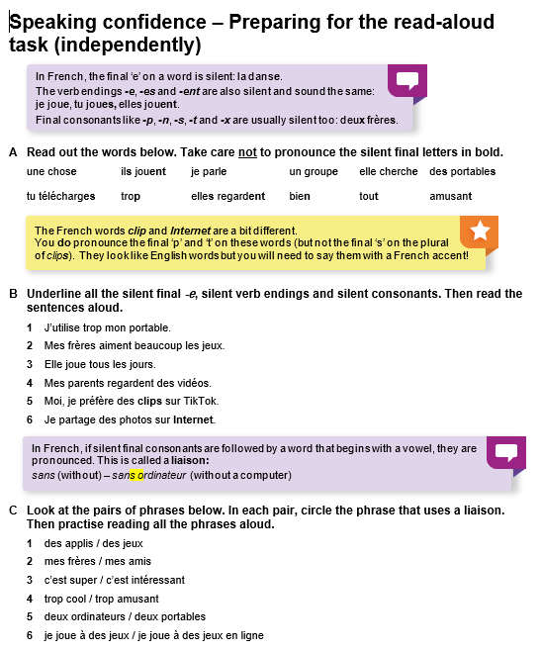


Slide 63


Slide 64



Slide 65


Slide 66



Slide 67


Slide 68



Slide 69


Slide 70



Slide 71


Slide 72



Slide 73


Slide 74



Slide 75


Slide 76



Slide 77


Slide 78



Slide 79


Slide 80



Slide 81


Slide 82


Slide 83


